Slide 1
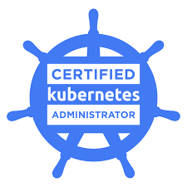
The Certified Kubernetes Administrator

Slide 3
Certified Kubernetes Administrator (CKA)
Online, Proctored Kubernetes Exams
https://www.cncf.io/certification/expert/cka/
– Curriculum was updated on September 1, 2020
The test consist of a set of scenarios to resolve from the command line in 2 hours; there is no multiple choice
https://training.linuxfoundation.org/cka-program-changes-2020/
v1.19

Slide 4
Course Introduction

Slide 5
Course Structure

Slide 6
1- Introduction to the fundamentals on what Kubernetes is, its origin and how it is a solution to all the challenges with managing applications at a large scale.
2- Introduces the Kubernetes architecture with all the control plane components that make up a Kubernetes cluster.
3- Goes through all the details on how to install and maintain a Kubernetes Kubeadm cluster
4- dives in all the Kubernetes Core concepts such as pods, labels, selectors and services
5- explains all the type of higher level workloads used to deploy applications

Slide 7
6- covers all aspect of scheduling pods in a Kubernetes cluster
7- teaches you how to configure your application data and secrets
8- dives in on how networking is implemented in Kubernetes for pod connectivity and reachability
9- is all about storage and explains how data for your application can stored and accessed by your applications
10 - All about on how to secure your API server with authentication and authorization

Slide 8
11- Covers how to monitor your applications health with metrics and logs.
12- all handson to install the Kubernetes cluster "the Hard way"
13- covers how to find and view information about your resources
14- Practice, Practice, Practice with troubleshooting labs

Slide 9


Slide 10
Exam Tips
add kubectl cheat link on k8s doc

Slide 11
Creating command aliases:
alias k="kubectl"
You only have 2 hours!! use kubectl autocomplete
$source <(kubectl completion bash | sed 's/kubectl/k/g')
$echo "source <(kubectl completion bash)" >> ~/.bashrc
Documentation using the cli..
$kubectl explain <resource_name>
Switching between multiple clusters
$kubectl config use-context <context_name>

Slide 12
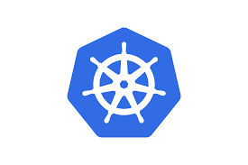
Introduction to Kubernetes
“The 30,000 feet view”

Slide 13
As Applications moved from one single block to a large number of deployable parts ie microservices, they became harder to manage.
monolith
application
microservices application
front
end
app
back end
app
front end
app
Web Tier
back end
app
App Tier
front
end
app
DB
app
DB
app
DB Tier

Slide 14
Google figured that managing their huge number of applications and service manually was no longer feasible..
there was also the need to be able massively scale their applications while remaining cost-efficient
it was time for something new!
Kubernetes was born

Slide 15

So..What is Kubernetes?
κυβερνήτης
It is Greek ...for “pilot” or “Helmsman”
A Production-Grade Container Orchestration Engine.

Slide 16
also known as K8s
K U B E R N E T E s
1 2 3 4 5 6 7 8

Slide 17
It is an open source project spun out from Google's internal system named Borg and Omega (~2 billion container per week)
It is a software system also known as the Linux Kernel of Distributed Systems.
It is a distributed, resilient and scalable architecture to deploy and manage containerized applications

Slide 18

Who “Manages” Kubernetes?
The CNCF is a child entity of the Linux Foundation and operates as a vendor neutral governance group.

Slide 19
Why containers?
Best utilization of server resources ..save $$$$
app isolation
portability
Abstracts underlying infrastructure…A cluster though composed of many servers appears as a single compute unit.
cloud native platform

Slide 20
Great for developers and users.. simple environment to host apps without the need to care about the infrastructure details
Focus is managing the app and not the infrastructure
Developers rely on services provided by Kubernetes.. they do not have to implement them as in the past or worry about them

Slide 21


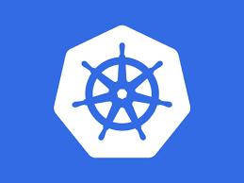
Developers be like..

Slide 22
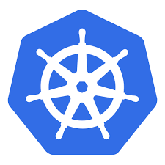

What can Kubernetes do for you?
heal and autoscale of your apps
make your apps always available and give them names..
automate the scheduling of your apps where you need them
manage your apps config and secrets

Slide 23
Me: “I want 3 healthy instances of Redis pods to always be running.”
Kubernetes: “Sir, I’ll ensure there are always 3 instances up and running.”
Kubernetes: “Sir, a pod has died. I’m going to attempt to spin up a new one.”

Slide 24
The Kubernetes Architecture

Slide 25
The Kubernetes Control Planes and {worker} Nodes

Slide 26
The Kubernetes cluster consist of a set of worker machines called Nodes. These nodes or worker nodes can be a hardware server or a Virtual Machine. A Cluster consists of a minimum of ONE worker node.
* K8s (worker) node == server (HW or VM)
The Kubernetes cluster is divided into TWO node types:
The control plane or master node(s) that controls, stores and manages the state of the cluster.
The worker nodes which host the containerized application workloads in pods.

Slide 27

K8s Control Plane or master node Components are run as linux systemd services or as static pods
The API server
The etcd distributed persistent storage
The controller manager
The Scheduler
**The arrows == REST API
Controller
Manager
Scheduler
API Server

Slide 28
K8s worker node Components are run as linux systemd services or as static pods
The kubelet
The kube Service proxy (kube-proxy)
The Container Runtime Interface or CRI
Kube-proxy
Kubelet
container runtime i/f (docker, etc...)

Slide 29
kubernetes cluster management is done using the
kubectl command line tool.
kubectl commands are used to interact and manage Kubernetes objects and the cluster.
$ kubectl [command] [TYPE] [NAME] [flags]
command: Specifies the operation ie..create, get, TYPE: Specifies the resource type...pod, replicaset
NAME: user defined name of the resource
flags: ie. -h for help

Slide 30

The Kubernetes Cluster Architecture:
master node (control plane)
worker node
Controller
Manager
Kube-proxy
Scheduler
Kubelet
kubectl
container runtime (docker, rkt etc...)
API Server

Slide 31
Add-on Components
The kubernetes DNS Service or CoreDNS
The Ingress Controller
The Container Network Interface Plugin or CNI
The Dashboard

Slide 32
The Kube API Server /
kube-apiserver

Slide 33
Provides a forward facing REST interface into the Kubernetes control plane and datastore.
It provides a CRUD (create,read,update and delete) interface to query and modify the state of the cluster using the REST API.
It stores the description of deployed resources in the etcd datastore and uses an optimized lock mechanism to prevent state corruption with simultaneous CRUD operation

Slide 34
All clients and other applications interact with kubernetes ONLY through the API Server. Clients can monitor any changes to deployed resources via the watch connection to the API server. The API server will send a notification.
The API server is the GATEKEEPER of the cluster by providing authentication, authorization, admission and validation of all requests to perform CRUD (create, read, update, delete) functions in the cluster.

Slide 35
MASTER NODE
ETCD
SCHEDULER
CONTROLLER
MANAGER
USER
kubectl
API Server
Authentication
Authorization
Admission
Validation
WORKER NODE
KUBELET
KUBE-PROXY

Slide 36

The ETCD aka the Datastore

Slide 37
Why ETCD in Kubernetes?
All resources configuration, state and metadata in a kubernetes cluster need to be stored in a persistent manner to survive a control plane node or API server failure.
The etcd is the ONLY place used to store all that data. It is the cluster backup drive.
The etcd is a distributed cluster datastore. Distributed so that more than one instance of etcd can run in a HA cluster and provide better performance

Slide 38
How is data stored in etcd?
All data stored under /registry
ETCD has 2 versions: v2 and v3 with v3 the recommended version..fast, massively scalable
etcd uses key-value pairs to store cluster data
in v2 keys can be directories or files with an associated value..keys can be listed using the ls command
in v3 key using directories are not supported but still be seen as used as directories.. need to use the get command with --prefix=true

Slide 39
The etcdctl command is used to interact with an etcd server such as setting, updating or removing keys.
Default is etcd is version 2 but can be set to version 3 by setting the environment variable ETCDCTL_API
export ETCDCTL_API=3
need to set CA certificate, etcd certificate key and server using the following environment variables:
export ETCDCTL_CACERT=/etc/kubernetes/pki/etcd/ca.crt
export ETCDCTL_CERT=/etc/kubernetes/pki/etcd/server.crt
export ETCDCTL_KEY=/etc/kubernetes/pki/etcd/server.key

Slide 40
The etcdctl command is used to interact with an etcd server such as setting, updating or removing keys.
Default is etcd is version 2 but can be set to version 3 by setting the environment variable ETCDCTL_API
export ETCDCTL_API=3
need to set CA certificate, etcd certificate key and server using the following environment variables:
export ETCDCTL_CACERT=/etc/kubernetes/pki/etcd/ca.crt
export ETCDCTL_CERT=/etc/kubernetes/pki/etcd/server.crt
export ETCDCTL_KEY=/etc/kubernetes/pki/etcd/server.key

Slide 41
containers:
- command:
- etcd
- --advertise-client-urls=https://192.168.50.101:2379
- --cert-file=/etc/kubernetes/pki/etcd/server.crt
- --client-cert-auth=true
- --data-dir=/var/lib/etcd
- --initial-advertise-peer-urls=https://192.168.50.101:2380
- --initial-cluster=master-1=https://192.168.50.101:2380
- --key-file=/etc/kubernetes/pki/etcd/server.key
- --listen-client-urls=https://127.0.0.1:2379,https://192.168.50.101:2379
- --listen-metrics-urls=http://127.0.0.1:2381
- --listen-peer-urls=https://192.168.50.101:2380
- --name=master-1
- --peer-cert-file=/etc/kubernetes/pki/etcd/peer.crt
- --peer-client-cert-auth=true
- --peer-key-file=/etc/kubernetes/pki/etcd/peer.key
- --peer-trusted-ca-file=/etc/kubernetes/pki/etcd/ca.crt
- --snapshot-count=10000
- --trusted-ca-file=/etc/kubernetes/pki/etcd/ca.crt
Static pod manifest of the etcd in kubeadm

Slide 42
root@master-1:~# etcdctl get / --keys-only --prefix --limit=5
/registry/apiregistration.k8s.io/apiservices/v1.
/registry/apiregistration.k8s.io/apiservices/v1.admissionregistration.k8s.io
/registry/apiregistration.k8s.io/apiservices/v1.apiextensions.k8s.io
/registry/apiregistration.k8s.io/apiservices/v1.apps
/registry/apiregistration.k8s.io/apiservices/v1.authentication.k8s.io

Slide 43
The Distributed ETCD Datastore

Slide 44
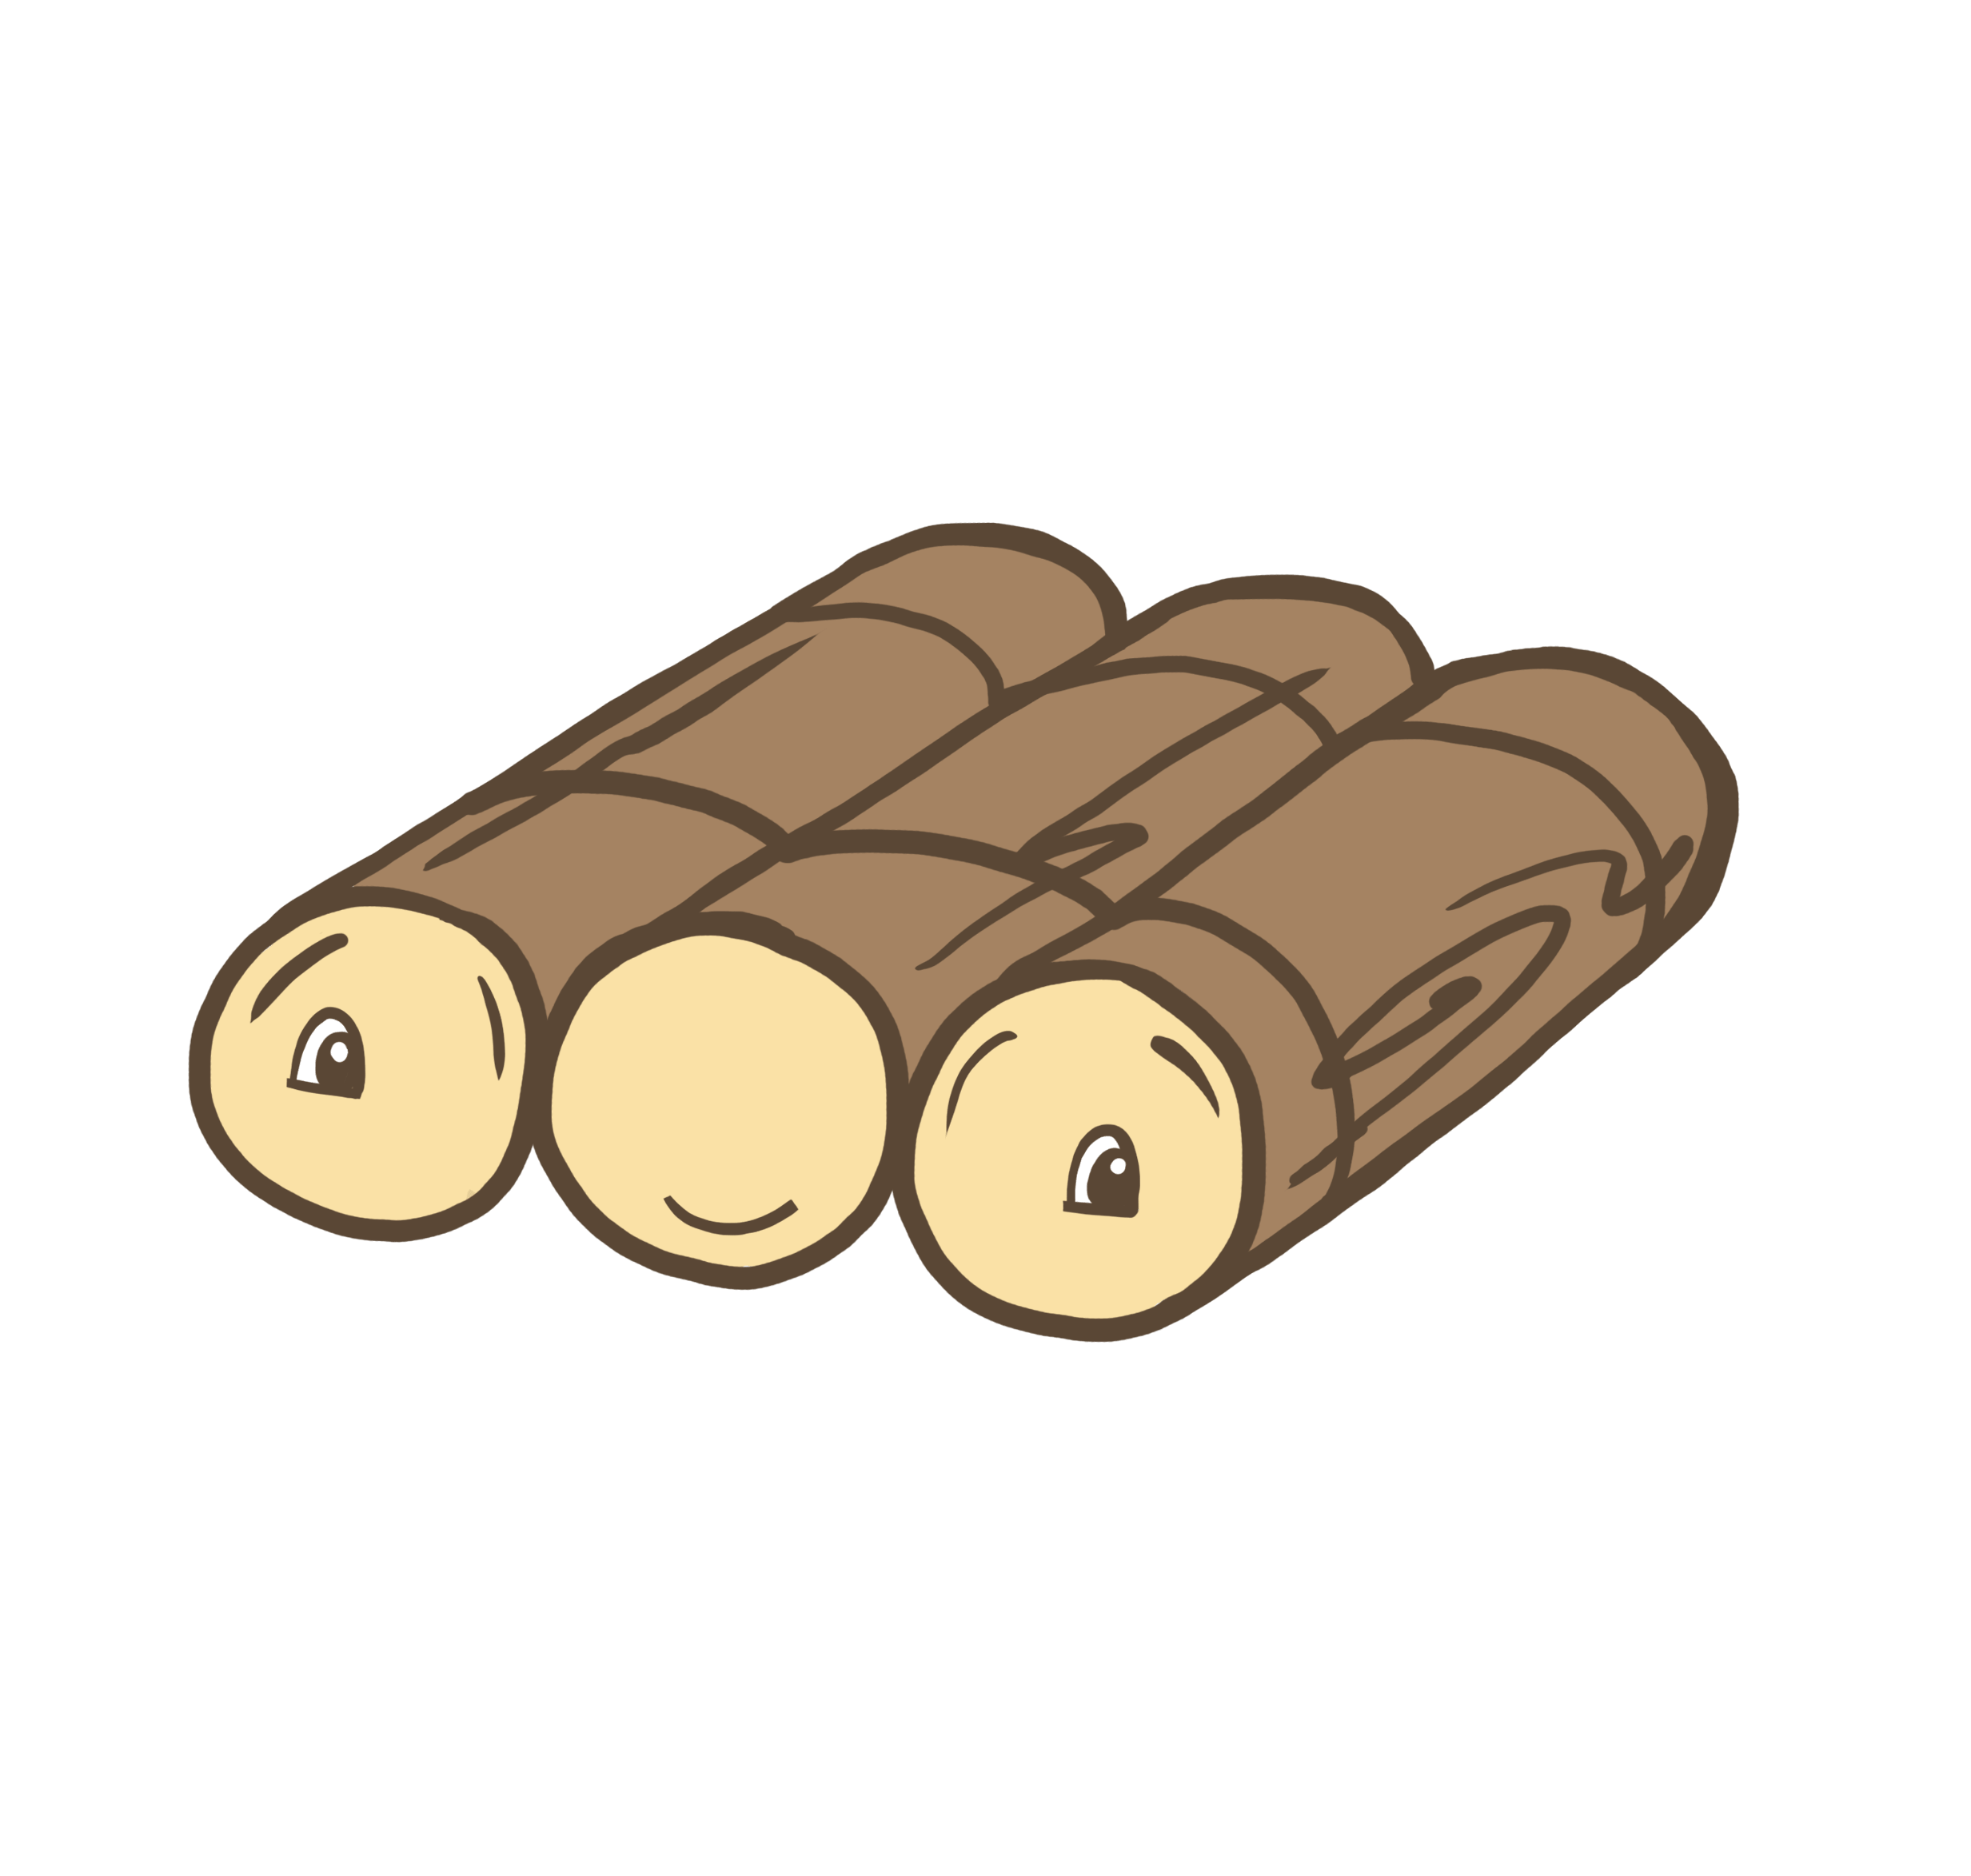
In a HA cluster, etcd uses the RAFT Consensus among a quorum (majority) of systems to determine the actual state of the Kubernetes cluster at any given time.
If no quorum is achieved then no changes to the state will be allowed.
This is why a K8s HA cluster should have an odd number of instances

Slide 45
The Controller Manager aka kube-controller-manager

Slide 46
The Controller Manager serves as the primary daemon that manages ALL controller processes
Each configurable resource in K8s has a corresponding controller process packaged in the kube controller manager
Each of these controllers do not communicate between each other and not aware of their existence. All done via the API server.

Slide 47
The controller manager has a manager component for every resource:
Node controller: monitoring node state
replication controller: maintaining the number of replicas in each node
replicaset controller
namespace controller
Deployment controller
and so on...

Slide 48
It is then acts as the cluster state Reconciliator and monitors the cluster state through the API server using the watch mechanism
It reconciles the state of the cluster by ensuring that the cluster desired state is ALWAYS the same as the actual state.

Slide 49
reconciliation loop using watch mechanism
ReplicaSet controller
WATCH
ReplicaSet , Pod
Service controller
WATCH
Services
Deployment controller
WATCH
Deployment
Namespace controller
WATCH
Namespace
CONTROLLER MANAGER
API SERVER

Slide 50
Replicaset controller will ALWAYS try and steer the cluster to its desired state:
Me: “I want 3 healthy instances of Redis to always be running.”
RScontroller: “Okay, I’ll ensure there are always 3 instances up and running.”
RScontroller: “Oh look, one has died. I’m going to attempt to spin up a new one.”

Slide 51
The Scheduler or kube-scheduler

Slide 52
The Scheduler is a complex policy engine that schedule pods to worker nodes with the following two steps:
1- Filtering: It will attempts to schedule it on matching nodes by first filtering out a list of acceptable nodes based on requirements.
2- Scoring: It will then prioritize and chose the best node using a scoring system. If multiple nodes have the same highest score then in a round robin fashion
.

Slide 53
Node eligibility Checks include:
general hardware requirements
resource availability
affinity/anti-affinity
labels matching node selector
taints and tolerations
specific node scheduling
storage requirements.
These checks must be passed before deemed eligible for scheduling.

Slide 54
NODE 01
NODE 01
NODE 02
Filtering
NODE 02
Scoring
NODE 02
NODE 03

Slide 55
WATCH
DIFF
RECONCILE

Slide 56
{worker} Node Components

Slide 57
The Kubelet aka The node agent

Slide 58
It is an agent running on each node responsible
Registers the worker node with the API server.
Manages the lifecycle of every pod on its host by instructing the container runtime engine to create needed containers. It watches the API server.
Kubelet gets the pods configuration from the API server and understands YAML container manifests

Slide 59
Ensures that ONLY containers declared in the pod manifest on the API server are running and are healthy.
Containers declared outside of K8s are not managed by Kubelet
Provides the support for static pods. Used as control planes components with kubeadm and minikube

Slide 60
The Kube Service Proxy
or
Kube-proxy

Slide 61
A couple of K8s key concepts...

Slide 62
Pods

Slide 63
Atomic unit or smallest “unit of work”of Kubernetes.
Pods are one or more containers that share volumes, a network namespace, and represent a single instance of an application.
They are EPHEMERAL!!
NODE
POD
network namespace 10.200.3.4
container
container
storage
pod network

Slide 64
Services

Slide 65
Network representation of the pods and their application using a durable IP or domain name
NOT Ephemeral!

Slide 66
a Service is a Layer 4 (TCP/UDP) load balancer that uses the DNAT to redirect inbound traffic to backend pods ie replaces service IP with target Pod IP :-)
The redirecting is performed by kube-proxy

Slide 67
kube-proxy

Slide 68
Called a proxy as it was actual proxy server or user space proxy. no longer used and no longer a "proxy"..
Replaced by linux netfilter iptables with better performance
kube-proxy triggers the configuration of routing rules by watching kube-apiserver for the addition and removal of Services and their Endpoints

Slide 69
User space...Actual proxy server...it opens a random port on that server. Any connections to this “proxy port” are proxied to one of the Service’s backend Pods. slow and no longer in use.
Iptables...it programs iptables rules for each service to do DNAT the service IP address to one of the Pod backing it.
It is the default mode
IPVS ...calls netlink interface to program IPVS rules and synchronizes IPVS rules with Kubernetes Services and Endpoints periodically.
it requires the Linux kernel to have the IPVS modules loaded.

Slide 70
Service IP=172.90.0.1:80
NODE-A
NODE-B
Kube-Proxy
POD2
10.20.1.2
POD1
src:10.20.0.1
dst:172.90.0.1:80
iptables rules
src: 10.20.0.1
<dst: 172.90.0.1:80>
dst: 10.20.1.2:8080

Slide 71
Service IP=172.90.0.1:80
NODE-A
NODE-B
Kube-Proxy
POD2
10.20.1.2
POD1
src: 10.20.0.1
dst: 172.90.0.1:80
iptables rules: NAT
src: 10.20.0.1
<dst: 172.90.0.1:80>
dst: 10.20.1.2:8080

Slide 72
The Container Runtime Interface

Slide 73
Problem:
"Docker and rkt were integrated directly and deeply into kubelet source code through internal and volatile interface"
Solution:
” In the Kubernetes 1.5 release, we are proud to introduce the Container Runtime Interface (CRI)
-- a plugin interface which enables kubelet to use a wide variety of container runtimes, without the need to recompile ”

Slide 74
A container runtime is the Container Runtime Interface compatible application that creates and manages containers.
docker
containerd
Rkt …..
kubelet communicates with the Container runtime over the container runtime interface
Kubelet
container runtime Interface
Docker, Rkt, Containerd, CRI-0

Slide 75
Understanding the REST API

Slide 76
REST is a network API and stands for Representational State Transfer…. exchange data between client and server in well-defined formats using URIs and HTTP
Use Uniform Resource Identifiers (URIs) to form a URL to address and manages each API object or resource.
http://api.server.com/my-resources/resource-name
(The forward slash (/) denotes hierarchy)
POST/GET/PUT/DELETE
SERVER
CLIENT
REST {API}
JSON/XML

Slide 77
A REST URL always has only one entrypoint or URL root to target a resource.
ie /api.example.com/collection/resource-id
A resource can be a singleton or a collection.
singleton is a singular object and a collection is a group of objects
For example, “bank_users” is a collection resources and “customer” is a singleton resource

Slide 78
Uses the the CRUD functions which map to HTTP verbs to perform actions in order to manipulate the state of a resource:
Create ------ POST
Read ------ GET
Update ------ PUT
Delete ------ DELETE

Slide 79
REST APIs use versioning for ease of management and to iterate faster when changes to the API are needed
//api.example.com/v1/customers/customer-id
"API versioning is the practice of transparently managing changes to your API"
changes do happen on the server side like data types, property naming or removal of that property can cause the API to break on the client side as they would no longer be able to get or interpret the data that requested

Slide 80
The Kubernetes API and Objects

Slide 81
The Kubernetes API is a RESTful API exposed by the API server and is the foundation of Kubernetes.

Slide 82
Kubernetes API groups and versioning

Slide 83
Everything within the Kubernetes is defined as an API object or resource.. pods, services, namespaces deployment, etc..
The Kubernetes API allows to query and manipulate their state using the kubectl cli or using RESTful API calls to ensure that the object exists.
Image Source

Slide 84
The Kubernetes REST API is organized in a hierarchy using a REST URL with /api or /apis as API entrypoints or root of the path.
API resources or objects are organized in REST collections called API groups. an API group is a collection of K8s objects or resources. Makes it easier to manage and extend the functionality of these objects or resources. /apis and /api are API group lists
Referenced within the resource or object configuration using the apiVersion and kind.

Slide 85
There are two types of K8s API groups:
The core (also called legacy) group is found at REST path /api/v1 (The core group name is not specified)
> apiVersion: v1
The named groups are at REST path /apis/$GROUP_NAME/$VERSION
> apiVersion: $GROUP_NAME/$VERSION (for example, batch/v1)

Slide 86
core group:
/api/<version>/namespace/<namespaces>/<resource>
named groups: /apis/<group>/<version>/namespace/<namespaces><resource>
apiVersion: v1 kind: Pod metadata:
name: pod-example namespace: default

Slide 87
The K8s API is versioned for ease of management and for adding changes to the API:
Three tiers of API maturity levels and referenced within the object configuration using apiVersion.
Alpha: Possibly buggy, And may change. Disabled by default.
Beta: Tested and considered stable. However API Schema may change. Enabled by default.
Stable: Released, stable and API schema will not change.
Enabled by default.

Slide 88
IMPORTANT: During the exam, the best way to find the apiVersion for an object and write a object manifest in yaml is to use the kubectl explain command.

Slide 89
K8s API Group and Versioning
Demo Lab

Slide 90
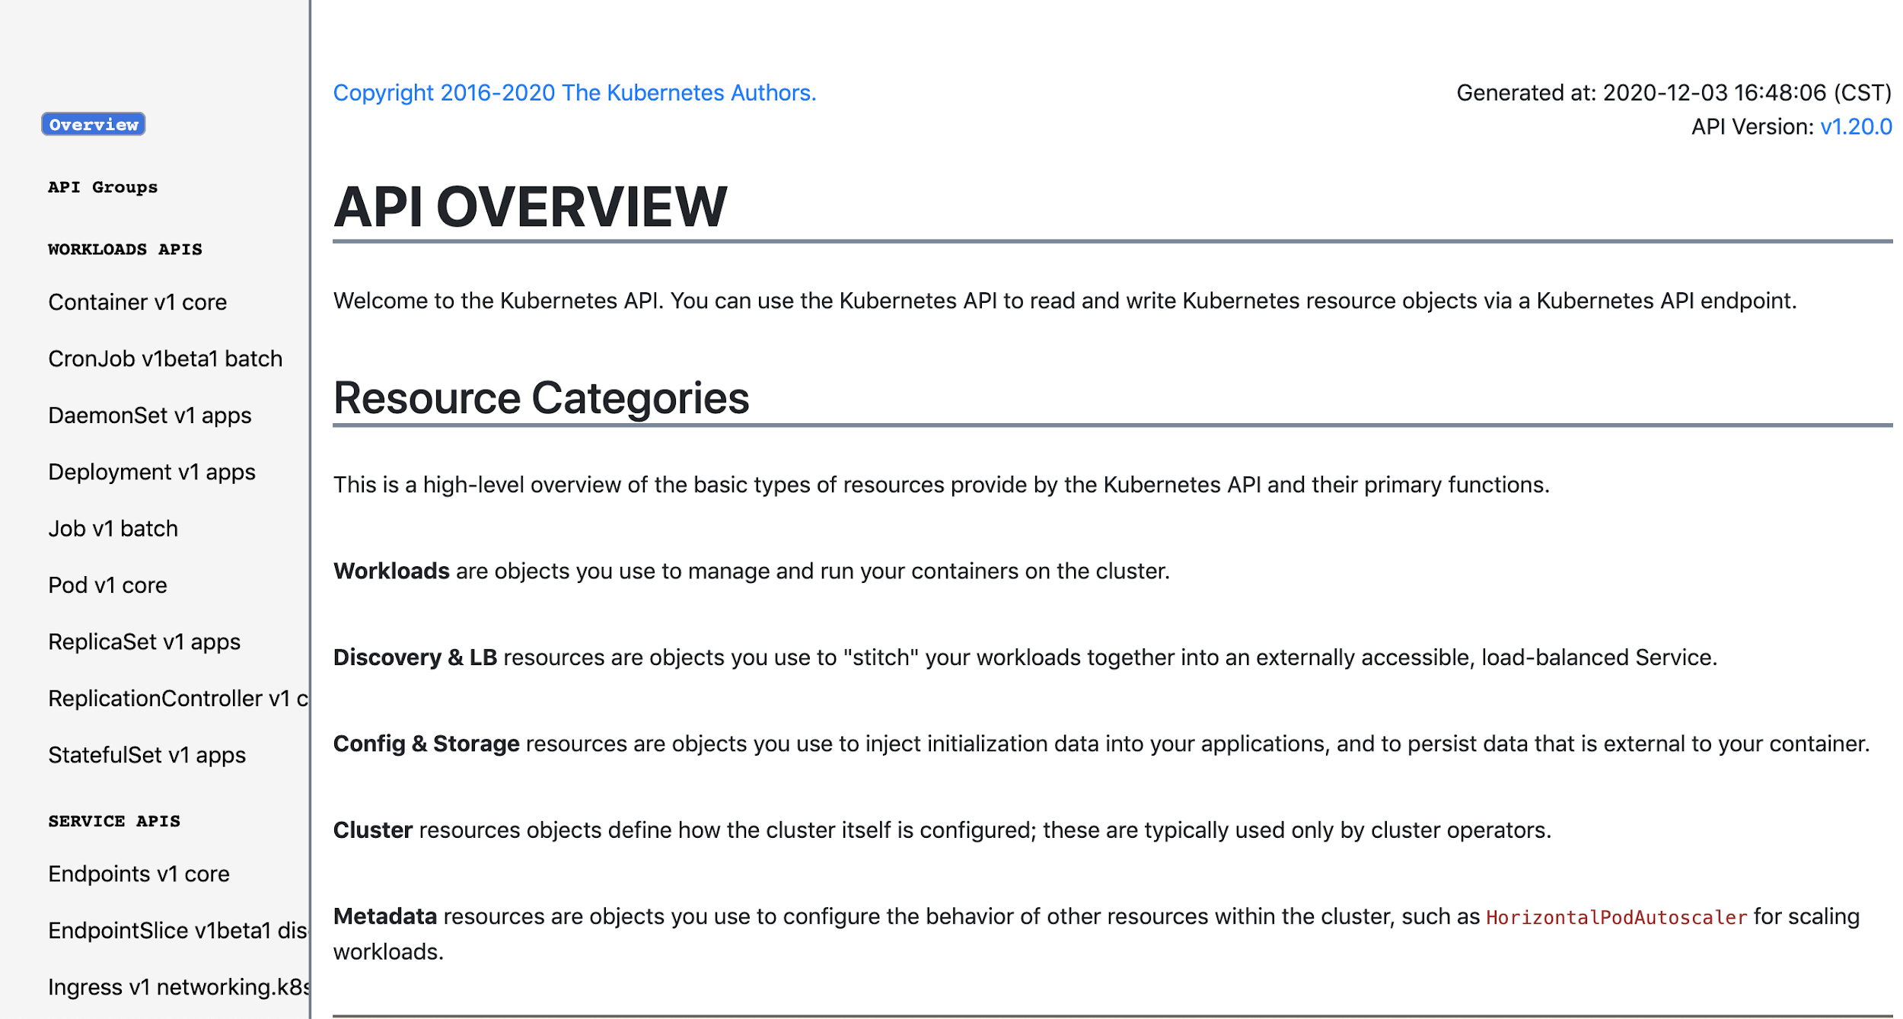
https://kubernetes.io/docs/reference/generated/kubernetes-api/v1.19

Slide 91
The Kubernetes Object Model

Slide 92
Kubernetes objects are entities used to deploy, maintain and scale applications in a cluster..ie Pods, replicatsets, deployments etc..
They collectively represent the state of the cluster.
Kubernetes works to ensure that the object exists by reconciling the desired end state with its actual state.

Slide 93
Kubernetes Objects are represented in configuration files or manifests using YAML or JSON.
YAML is preferred as it is a human readable. Uses indentation to denote ownership.
Kubernetes manifests use 3 basic data types:
mapping - key:value or hash or dictionary,
sequence - array or list of values
scalar - single value as string, number, boolean etc

Slide 94
Object Model Requirements in manifests:
apiVersion: Kubernetes API version of the Object
kind: Type of Kubernetes Object
metadata.name: Unique name of the Object
metadata.namespace: defaults to current namespace or specify namespace if other than current namespace.
spec: Describes the desired end state or configuration of the object to be created.

Slide 95
Only 2 pod running
1 pod missing
add a new pod
Desired End State
Actual State
spec:
replicas: 3
template:
spec:
containers:
- name: container1
- image: nginx
new pod added
POD 1
POD3

Slide 96
apiVersion: v1 kind: Pod metadata:
name: webapp spec:
containers:
name: container1 image: nginx
name: container2 image: busybox
Scalar
string
Map or Dictionary
Array or List

Slide 97
YAML vs JSON
{
"apiVersion": "v1",
"kind": "Pod", "metadata": {
"name": "webapp"
},
"spec": { "containers": [
{
"name": "nginx",
"image": "nginx",
"ports": [ { "containerPort": 80 }]
}
]
}
}
apiVersion: v1 kind: Pod metadata:
name: webapp
spec:
containers:
- name: nginx
image: nginx
ports:
- containerPort: 80

Slide 98
Object desired state vs Actual State
The object state governed by following fields:
spec - Describes the desired end state or configuration of the object to be created.
status - Description of the actual state of the object and its history.

Slide 99
Desired State vs Actual State
Pod spec- desired end state
apiVersion: v1 kind: Pod metadata:
name: pod-example spec:
containers:
- name: nginx
image: nginx:stable-alpine ports:
- containerPort: 80
Pod Status - actual state
status: conditions:
lastProbeTime: null
lastTransitionTime: 2018-02-14T14:15:52Z status: "True"
type: Ready
lastProbeTime: null
lastTransitionTime: 2018-02-14T14:15:49Z status: "True"
type: Initialized
lastProbeTime: null
lastTransitionTime: 2018-02-14T14:15:49Z status: "True

Slide 100
Kubernetes Core Concepts

Slide 101
Core Concepts
Kubernetes has several core building blocks that make up the foundation of their higher level components.
Contexts
Namespaces
Pods
Labels
Selectors

Slide 102
Namespaces

Slide 103
Namespaces are a mechanism of partitioning resources in a cluster into distinct groups.
A single cluster should provide concept of multi tenancy by providing logically isolated environments for users or group of users to run their applications on the same cluster.
ie ...Dev vs QA vs Production running same applications but with different configurations based on their environment.

Slide 104
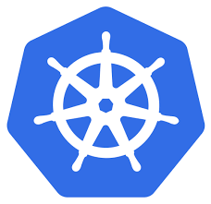
KUBERNETES
CLUSTER
namespace DEV
namespace QA
APP1
APP2
APP1
APP2
namespace PROD
APP1
APP2
APP3

Slide 105
Provides a scope for resources:
namespaces
cluster
Some things to watch out for..
a Namespace name is a DNS compatible label.
should be created before adding objects to it
must not be deleted if there is content associated with it.

Slide 106
Must be added in the K8s API URI to manage objects
**entrypoint api or apis
POST | /apigroup/{version}/namespaces/{namespace}/{resourceType}
GET | /apigroup/{version}/namespaces/{namespace}/{resourceType}/{name}
PUT | /apigroup/{version}/namespaces/{namespace}/{resourceType}/{name}
DELETE | /apigroup/{version}/namespaces/{namespace}/{resourceType}/{name}

Slide 107
The default K8s namespaces are:
default: The default namespace for any object without a namespace.
kube-system: Acts as
the home for objects and resources created by Kubernetes itself.
kube-public: A special namespace; readable by all users that is reserved for cluster bootstrapping and configuration.

Slide 108
Namespaces Demo Lab

Slide 109
Pods

Slide 110
So..why Pods and not just containers??
NO container resource in Kubernetes. Always part of a pod.
Containers should only run one process.
an application may need to run multiple unrelated processes and Kubernetes uses pods to manage them as a single unit.

Slide 111
Pods are the Atomic unit or smallest “unit of work”of Kubernetes to host a singular instance of an application
Namespaced resource

Slide 112
NODE-01
POD-A
POD-C
APP
APP
POD-B
APP

Slide 113
A pod cannot span across nodes. Can only be hosted by one node.
node01
node02
POD-A
POD-C
POD-B

Slide 114
Docker Hub or any container registry of container images
NODE
POD
network namespace 10.200.3.4
Pod assigned a unique IP address and is a network namespace.
All the containers within a pod share the same pod IP.
container
container
storage
pod network

Slide 115
They are EPHEMERAL!
They are not designed to run forever.. when a Pod is deleted or terminated by a user or by a controller process, it cannot be restored.
How?
a Pod can be deleted if a node fails or can be evicted from a node if it does not have enough resource.

Slide 116
boss@kube-master:~$ kubectl get pods app1
NAME READY STATUS RESTARTS AGE
app1 1/1 Running 0 40h
READY column is displaying 1/1 ...1 meaning that this pod has only one container and 1 meaning it is ready. (1 ready, 0 not ready)
STATUS is running, which means that the pod is running
RESTARTS column represents how many times this pod was restarted. Kubernetes will attempt to restart a failing pod whenever it fails.
AGE represents how much time has passed since this pod was created.

Slide 117
Some Pod Phases ..
Pending: Pod has been created and accepted by the cluster but not assigned to a node or one of its containers are not yet running.
Running: Pod has been bound to a node and all of the containers have been created.
ContainerCreating: containers are being created and would be a problem if stuck in this state
Succeeded: All containers in the Pod have terminated successfully.
Failed: one or more containers in the Pod have failed and terminated
Unknown: The state of the Pod cannot be determined.

Slide 118
Pod admin useful commands
kubectl run command
kubectl create -f pod-manifest.yaml
kubectl describe pod
kubectl get pod -o wide
kubectl get pod -o yaml >> filename.yaml
kubectl edit pod
kubectl apply -f pod-manifest.yaml
kubectl replace -f pod-manifest.yaml (pod need to exist)
kubectl set image pod container-name=image-name
kubectl delete pod

Slide 119
Pods Demo Lab

Slide 120
Static Pods

Slide 121
Static Pods are like Pods but managed by Kubelet instead of the API Server. Kubelet runs as a linux systemd service on each node.
The API server keeps a read only copy or mirror pods for visibility.
you can create them on any nodes since the kubelet runs on every node. ie in the event you lose your control plane nodes…..Kubeadm runs all control plane components as static pods

Slide 122
How the Kubelet creates and manages them:
It watches the location where the pod manifest are stored using the --manifest-url or --pod-manifest-path
The location can also defined in the kubelet config file located at /var/lib/kubelet/config.yaml using the staticPodPath entry. it overwrites the service arguments --manifest-url or --pod-manifest-path
Deleting the pod manifest deletes the pod.

Slide 123
Static Pods Demo Lab

Slide 124
Init Containers

Slide 125
Why use Init Containers..? It allows to decouple application initialization from the app itself..
They can be managed by different teams with different levels of authentication and authorization. An app container cannot start until all init containers have executed succesfully.
Used to init some data for a database or setting up account or installing some update before running an application

Slide 126
What is an Init Container?
part of a pod configuration
starts and executes before any other containers in the pod
should contain simple logic such as a small startup script.
If more than one, init containers are executed sequentially.

Slide 127
POD
………..
init
con1
init con
2
init
con
n
Application Container

Slide 128
POD
………..
1
init
con1
init con
2
init
con
n
Application Container

Slide 129
POD
………..
1
init
con1
init con
2
init
con
n
Application Container
2

Slide 130
What to watch out for when using Init Containers?
if an init container fails, the pod is restarted
unless the restartPolicy is set to never..re execute all init containers and app containers
They can share all pod resource such as volumes
beware of resource limits as pod puts priority on init containers..pod could be stuck in pending by scheduler though resource available for app container.

Slide 131
Init Container Demo Lab

Slide 132
Labels

Slide 133
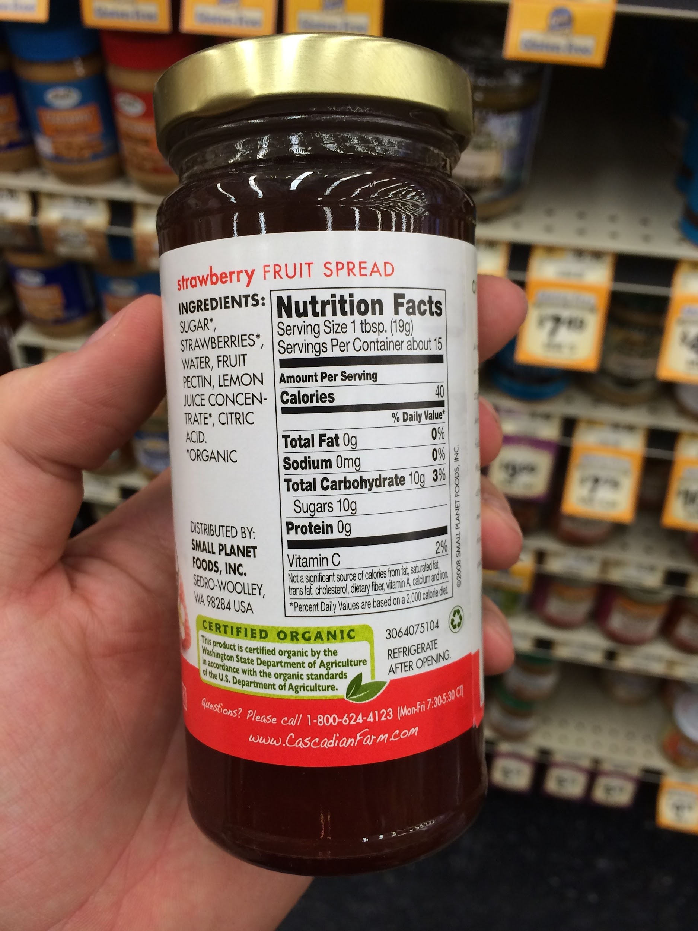

Slide 134
Labels are attached to resources (pod, deployments, daemonsets etc..)
used to identify, describe and group related sets of resources around functionality or common attributes like release type or team etc..
Labels are NOT a unique identifier for a resource.
One or more labels can be added imperatively or declaratively at creation or at a later stage.
They can also be modified any time.

Slide 135
Labels are key:value pairs of string data type.
The key being the name of the label
configured in the metadata.
Each key has to be unique when more than one label is defined.
There is a specific syntax for the label:
https://kubernetes.io/docs/concepts/overview/working-with-objects/labels/#syntax-and-character-set
NODE-A
team=prod
POD
env=prod
app=front-web
container
A
container
B
storage
pod network

Slide 136
Selectors aka Label Selectors..

Slide 137
Labels are attached to resources so that you can use to group them.
Label Selectors use Labels to filter out by listing a subset of resources but also to perform action on a that subset of resources such pods or nodes.
.

Slide 138
env=dev
app=web
rel=alpha
env=dev
app=web
rel=beta
app=back
env=dev
app=web
rel=alpha
rel=beta
app=back
selector-1
env=dev
app=web
selector-2
rel=alpha
selector-3
rel=beta
app=back

Slide 139
Selector Types
Set-based selectors are supported on a limited subset of objects.
They provide a method of filtering on a set of values using operators:
In, NotIn, Exists or DoesNotExist
Equality based selectors allow for simple filtering:
=, == or !=
selector:
matchLabels:
env: prod
app: frontend
selector: matchExpressions:
- key: env operator: In
- values: [prod,dev]

Slide 140
Selector command to use with the selector types:
kubectl get <resource> -l <label>

Slide 141
Annotations

Slide 142
They provide descriptive information about the resource as part of the metadata using an unstructured key:value pair.
Annotation can be set manually in the configuration to pods or other resources or be set by the Kubernetes system or other external tools.
Unlike labels and selectors, Annotations can contains a large amount of data.
$kubectl annotate command

Slide 143
Build, release, or image information like timestamps, release IDs, git branch, PR numbers,
Client library or tool information like name, version, and build information.
Phone or email of persons responsible or sites url where information can be found in case of a problem
introduce new features in alpha and beta API ver without the need to add a configuration field for a new object

Slide 144
Introducing Kubernetes Services

Slide 145
Cloud native application are designed to receive requests from other apps or external clients. With microservices, each app provide a particular service for other apps.
There are challenges with accessing Apps in Pods over the network with Kubernetes..

Slide 146
need to send a HTTP request to the frontend app
whats the service IP address ??
front end
service
IP address of Pods only assigned to a pod when created
backend
pod

Slide 147
front end
app service
frontapp pod
10.244.5.12
backend
pod

Slide 148
The IP is no longer reachable..what happened
front end
app service
frontapp pod
10.244.5.12
backend
pod
X
frontapp pod
10.244.10.3

Slide 149
Which Pod do I connect to??
Just give me ONE IP address….can't keep track
front end
service
frontapp pod
backend
pod
frontapp
pod
frontapp
pod

Slide 150
a Service is a namespaced Kubernetes resource to provide a single and consistent way of accessing the exposed workloads of Pods.
Clients can access applications without knowing the location of the pods or their IP address
Services are a durable resource .. Not ephemeral

Slide 151
static cluster-unique IP
static namespaced DNS name
<service name>.<namespace>.svc.cluster.local

Slide 152

Remember selectors...Services select Pods using equality based selectors using Pod labels.
Uses kube-proxy to provide simple load-balancing. kube-proxy acts as a daemon that creates rules in the host’s iptables for every service to nat the service IP to a pod IP.
app=web
service
app=web
app=db
app=web

Slide 153
Service Types
There are 4 major service types:
ClusterIP (default)
NodePort
LoadBalancer
ExternalName

Slide 154
The ClusterIP Service

Slide 155
The ClusterIP service exposes a service on a strictly cluster internal virtual IP ...it is only accessible from within the cluster.
Allows to expose a group of pods to other group(s) of pods within the cluster.
By default, kube-proxy in iptables mode chooses a backend at random.

Slide 156
Target Port vs Port
Target Port: Port of the container that is exposed by the service. It is the port of the target container by the service.
Port: Port of the service itself
By default and for convenience, the `targetPort` is set to the same value as the `port` field.
apiVersion: v1 kind: Service metadata:
name: web-svc
spec:
selector: app: nginx env: prod
ports:
- protocol: TCP port: 80
targetPort: 80

Slide 157
POD
TARGET PORT
Service
PORT

Slide 158
API SERVER
WEB service
DB service
NODE-01
NODE-02
KUBE-
PROXY
KUBE-
PROXY
DB
webapp
DB
IPTABLES
backend
IPTABLES
webapp

Slide 159
API SERVER
WEB service
DB service
NODE-01
NODE-02
KUBE-
PROXY
KUBE-
PROXY
DB
webapp
IPTABLES
backend
IPTABLES
webapp

Slide 160
API SERVER
WEB service
DB service
NODE-01
NODE-02
KUBE-
PROXY
KUBE-
PROXY
DB
webapp
IPTABLES
IPTABLES
backend
webapp

Slide 161
API SERVER
WEB service
DB service
NODE-01
NODE-02
KUBE-
PROXY
KUBE-
PROXY
DB
webapp
DB
IPTABLES
backend
IPTABLES
webapp

Slide 162
ClusterIP Service Demo Lab

Slide 163
k exec -it pod sh
# curl appsvc.dev.svc.cluster.local
# cat /etc/resolv.conf
# env
k expose clusterip --tcp=
k expose pod name --name= --selector= --port= --target-port=
k expode svc name --name= --selector= --port --target-port
name your service targetport with name of containerport so no service reconfig when doing container port changes

Slide 164
NodePort Service

Slide 165
The NodePort service extends the ClusterIP service.
It allows external users to access cluster endpoints.
It exposes a port named NodePort on all worker nodes. External users can access cluster endpoints via:
<any worker node IP>:nodePort.
This nodePort is dynamically taken from a range between 30000-32767 by default but can be statically defined.

Slide 166
Service
10.109.77.234
selector:
app=frontend
http://192.168.30.1:30333
Port: 80
Nodeport: 30333
NODE-01
192.168.30.1
NODE-02
192.168.30.2
IPTABLES
KUBE-
PROXY
Targetport: 8000
Targetport: 8000
POD-B
10.96.1.10
Label: app=frontend
POD-A
10.36.0.6
Label: app=frontend

Slide 167
Service
10.109.77.234
selector:
app=frontend
Port: 80
http://192.168.30.1:30333
Nodeport: 30333
NODE-01
192.168.30.1
NODE-02
192.168.30.2
-d 10.109.77.234:80
IPTABLES
KUBE-
PROXY
Targetport: 8000
Targetport: 8000
POD-B
10.96.1.10
Label: app=frontend
POD-A
10.36.0.6
Label: app=frontend

Slide 168
Service
10.109.77.234
selector:
app=frontend
http://192.168.30.1:30333
Port: 80
Nodeport: 30333
NODE-01
192.168.30.1
NODE-02
192.168.30.2
-d 10.109.77.234:80
IPTABLES
KUBE-
PROXY
Targetport: 8000
Targetport: 8000
-d 10.36.0.6:8000
POD-B
10.96.1.10
Label: app=frontend
POD-A
10.36.0.6
Label: app=frontend

Slide 169
Service
10.109.77.234
selector:
app=frontend
Port: 80
http://192.168.30.1:30333
Nodeport: 30333
Nodeport: 30333
NODE-01
192.168.30.1
NODE-02
192.168.30.2
IPTABLES
-d 10.96.1.10:8000
Targetport: 8000
POD-B
10.96.1.10
Label: app=frontend
KUBE-
PROXY
Targetport: 8000
POD-A
10.36.0.6
Label: app=frontend

Slide 170
External users can access endpoint via any of the nodes hosting the services endpoints using the same nodePort.
However the challenge is that the the external users would lose access if that node fails….

Slide 171
NodePort Service Demo Lab

Slide 172
Load Balancer Service

Slide 173
The LoadBalancer service extends the NodePort service by addressing the nodeport challenge of losing access when a node fails.
The worker nodes become a part of the server pool of the load balancer with the external users connecting the load balancer IP address in order to connect to the endpoints

Slide 174
Note: LoadBalancer builds on NodePort and creates an external load-balancer (if supported in the current cloud such as AWS, GCP, Azure)
It would not happen when used with Kubeadm or minikube though you can use the externalIPs argument in the service configuration

Slide 175
curl 18.100.30.1
Load Balancer
18.100.30.1
Service
10.109.77.234
selector:
app=frontend
Port: 80
Nodeport: 30333
Nodeport: 30333
NODE-01
192.168.30.1
NODE-02
192.168.30.2
IPTABLES
KUBE-
PROXY
Targetport: 8000
Targetport: 8000
POD-B
10.96.1.10
Label: app=frontend
POD-A
10.36.0.6
Label: app=frontend

Slide 176
curl 18.100.30.1
Load Balancer
18.100.30.1
Service
10.109.77.234
selector:
app=frontend
Port: 80
-d 192.168.30.(?):30333
Nodeport: 30333
Nodeport: 30333
NODE-01
192.168.30.1
NODE-02
192.168.30.2
IPTABLES
KUBE-
PROXY
Targetport: 8000
Targetport: 8000
POD-B
10.96.1.10
Label: app=frontend
POD-A
10.36.0.6
Label: app=frontend

Slide 177
curl 18.100.30.1
Load Balancer
18.100.30.1
Service
10.109.77.234
selector:
app=frontend
Port: 80
-d 192.168.30.(?):30333
Nodeport: 30333
Nodeport: 30333
NODE-01
192.168.30.1
NODE-02
192.168.30.2
-d 10.109.77.234:80
IPTABLES
KUBE-
PROXY
Targetport: 8000
Targetport: 8000
POD-B
10.96.1.10
Label: app=frontend
POD-A
10.36.0.6
Label: app=frontend

Slide 178
curl 18.100.30.1
Load Balancer
18.100.30.1
Service
10.109.77.234
selector:
app=frontend
Port: 80
-d 192.168.30.(?):30333
Nodeport: 30333
Nodeport: 30333
NODE-01
192.168.30.1
NODE-02
192.168.30.2
-d 10.109.77.234:80
IPTABLES
KUBE-
PROXY
Targetport: 8000
Targetport: 8000
-d 10.36.0.6:8000
POD-B
10.96.1.10
Label: app=frontend
POD-A
10.36.0.6
Label: app=frontend

Slide 179
Load Balancer Service Demo LAB
Please remember to clean up your environment when using public cloud.
$kubectl delete svc,pod --all

Slide 180
External Name Service

Slide 181
ExternalName service is used to reference endpoints OUTSIDE of the cluster.
Creates an internal CNAME DNS entry that aliases another.
apiVersion: v1 kind: Service metadata:
name: example-prod spec:
type: ExternalName spec:
externalName: example.com

Slide 182
Workloads and the Pod Template

Slide 183
Workloads within Kubernetes are higher level objects that manage Pods or other higher level objects.
ALL Workloads use a pod template as part of the desired end state in their configuration.
Workload Controllers manage instances of Pods based off a provided template.

Slide 184
Workloads within Kubernetes are higher level objects that manage Pods or other higher level objects. In ALL CASES a Pod Template is included.
ReplicaSet
Deployment
DaemonSet
StatefulSet
Job
CronJob

Slide 185

workload configuration
POD Template

Slide 186
Pod Template
apiVersion: v1 kind: Pod metadata:
name: pod-example labels:
app: nginx spec:
containers:
- name: nginx image: nginx
template: metadata:
labels: app: nginx
spec:
containers:
- name: nginx image: nginx
Pod Templates are Pod specs with limited metadata.

Slide 187
The ReplicaSet

Slide 188
ReplicaSets create and manages a set of pod replicas based on the number of replicas defined in the config.
Uses selectors to select running pods with matching labels and uses the pod template to create pod replicas
If a pod part of a replicaset is terminated, the replicaset will replace it by creating a new pod using the pod template.

Slide 189
replicas: The desired number of instances of the Pod.
selector: Supports both equality based or set-based selector types.
template: pod template to create pod replicas to match the desired number of Pod declared in the replicas field.
apiVersion: apps/v1 kind: ReplicaSet metadata:
name: rs-example spec:
replicas: 3 selector:
matchLabels: app: nginx env: prod
template:
<pod template>

Slide 190
REFRESHER: Set-based selector operators:
In: match pods with the label name key and one of the label values. Either one or the other.
NotIn: match pods with any label values other than the one specified for the label name key
Exists: match any pod with the label name as key . no need to specify values.
DoesNotExist: match any label other the label name specified as key

Slide 191
Node 01
Node 02
POD web-34ad
label:
app=web
POD-B
label:
env=dev
POD
web-554nj
label:
app=web
ReplicaSet
selector: app=web
replicas: 2

Slide 192
Node 01 >NODE FAILURE
Node 02
POD
web-ui88
label:
app=web
POD-B
DELETED
POD
web-web-554nj
label:
app=web
ReplicaSet
selector: app=web
replicas: 2

Slide 193
ReplicaSets Demo Lab

Slide 194
Deployments

Slide 195
Once you have deployed an application, you will have to update it at some point whether its ia a bug fix or to add on more features. This can be done imperatively but some downtime.
ReplicaSets
SERVICE
PODS
Application

Slide 196
Deployments are the Kubernetes method of updating applications declaratively (let K8s do it for you) and with true zero downtime….
Deployments are a namespaced higher level resource which manages lower level resources such as as replicaSets which manage their pod replicas..these replicaSets should not be managed outside of the deployment.
Deployment
ReplicaSet
POD

Slide 197
Each replicaSet managed by the deployment can be identified by a unique label.
This label named pod-hash-template is added by the Deployment controller to every ReplicaSet and its pods that a Deployment creates or adopts via selectors.
boss@kube-master:~$ kubectl get rs
NAME DESIRED CURRENT READY AGE
rs1 3 3 3 13h
test-5f6778868d 2 2 2 13h

Slide 198
When there is a need to update to a new version of an application, the deployment resource have two deployment strategies:
RollingUpdate: used when an applications supports running multiple versions at the same time. deletes pods of the older version while adding pods of the new version at the same time ensuring no downtime for the application.
Recreate: All existing Pods are deleted before the new ones are created.. This will cause downtime.

Slide 199
Upgrading an app require creating a new replicaSet as pod template is updated with the new image version.
Deployments keep track of all the app versions by using deployment revision number system
revision history
revision 1
replicaset v1
revision 2
replicaset v2
revision N
replicaset vN
. . . .
pods
your_deployment

Slide 200
The number of revisions stored is configurable in the deployment spec
revision history
revision 1
replicaset v1
revision 2
replicaset v2
revision N
replicaset vN
. . . .
pods
v2
your_deployment

Slide 201
The number of revisions stored is configurable in the deployment spec
revision history
revision 1
replicaset v1
revision 2
replicaset v2
revision N
replicaset vN
. . . .
pods
v(n)
your_deployment

Slide 202
Users can rollback to a previous revision known to be stable and working in case of trouble..
revision history
revision 1
replicaset v1
revision 2
replicaset v2
revision N
replicaset vN
. . . .
pods
v2
your_deployment

Slide 203
revisionHistoryLimit: The number of previous deployment revisions replicasets to retain.
strategy:
RollingUpdate: (default)
maxSurge: maximum number of Pods that can be created over the desired number of Pods (number or % of desired)
maxUnavailable: maximum number of Pods that can be unavailable during the update process relative to the desired count (number or % of desired)
Recreate: All existing Pods are deleted first before the new ones are created.
apiVersion: apps/v1 kind: Deployment metadata:
name: web-app
spec:
replicas: 4
revisionHistoryLimit: 2 selector:
matchLabels:
app: web
strategy:
type: RollingUpdate rollingUpdate:
maxSurge: 1
maxUnavailable: 1 template:
<pod template>

Slide 204
RollingUpdate Strategy
updating the updating pod template generates a new ReplicaSet revision and a new pod-template-hash.
POD 1
deployment
ReplicaSet
POD 2
POD 3

Slide 205
RollingUpdate Strategy
updating the updating pod template generates a new ReplicaSet revision and a new pod-template-hash.
POD 1
deployment revision 2
ReplicaSet
revision 1
POD 2
POD 3
ReplicaSet
revision 2

Slide 206
RollingUpdate Strategy
New deployment revision created and scales up ReplicaSet Revision2 to add one more pod based on the maxSurge value.
POD 1
ReplicaSet
revision 1
deployment revision 2
POD 2
POD 3
ReplicaSet
revision 2
POD 1

Slide 207
revision 1 pod deleted based on maxUnavailable and revision 2 pod added based on maxSurge
POD 1
ReplicaSet
revision 1
POD 2
deployment revision 2
POD 3
POD 1
ReplicaSet
revision 2
POD 2

Slide 208
revision 1 pod deleted based on maxUnavailable and revision 2 pod added based on maxSurge
POD 1
POD 2
ReplicaSet
revision 1
POD 3
deployment revision 2
POD 1
POD 2
ReplicaSet
revision 2
POD 3

Slide 209
deployment deleted all pods of revision 1
POD 1
POD 2
ReplicaSet
revision 1
POD 3
deployment revision 2
POD 1
POD 2
ReplicaSet
revision 2
POD 3

Slide 210
Deployment Revision 2 update completed. rollbacks to a previous revision are possible by undoing rollouts.
Revision History
ReplicaSet
revision 1
deployment revision 2
POD 1
ReplicaSet
revision 2
POD 2
POD 3

Slide 211
TIP.. Preventing bad application rollouts:
Using minReadySecond can specify the amount of time a pod is ready before the pod is declared as available for use.
Allows to prevent the rollout of bad application versions when used in combination with readiness probes
Pausing a rollout using the command:
$ kubectl rollout pause deploy <deployment_name>

Slide 212
Deployments Demo Lab

Slide 213
## Deployment lab commands
$kubectl create -f deploy-manifest --record
$kubectl rollout status deploy deploy-name
$kubectl get rs ..see deploy rs with pod temp hash
$kubectl set image deployment deploy-name / container-name=new-image
$kubectl rollout history deploy deploy-name --revision=<rev#>
$kubectl rollout undo deployment deploy-name
$kubectl rollout undo deployment deploy-name --to-revision=<rev#>

Slide 214
DaemonSets

Slide 215
DaemonSets are similar to replicaSets as it creates pod replicas using a pod template.
Differs as it creates and manages ONE single pod replica on each worker node in a cluster.
Bypasses the default scheduling.

Slide 216
Typically used for system services such as log forwarding, security and health monitoring
updates are managed via revisions and a controller-revision-hash label attached to the daemonsets pods.

Slide 217
revisionHistoryLimit: The number of previous iterations of the DaemonSet to retain.
updateStrategy: Describes the method of updating the Pods based on two types:.
RollingUpdate: (default) Cycles through updating the Pods according to the value of maxUnavailable.
OnDelete: The new instance of the Pod is deployed ONLY after the current instance is deleted.
nodeSelector: equality based Selector for matching node labels
apiVersion: apps/v1 kind: DaemonSet metadata:
name: ds
spec:
revisionHistoryLimit: 3 selector:
matchLabels: app: nginx
updateStrategy:
type: RollingUpdate rollingUpdate:
maxUnavailable: 1 template:
spec:
nodeSelector: nodeType: edge
<pod template>

Slide 218
DaemonSet Demo Lab

Slide 219
DaemonSet Lab command sheet:
$kubectl get pod -n kube-system -o wide
$kubectl get ds -n kube-system
$kubectl create -f dsapp
$kubectl get ds
$kubectl get pod
$kubectl describe ds
$kubectl delete ds
## ds is a cli shorthand for daemonset.

Slide 220
Job

Slide 221
Job is a controller that ensures one or more pods are executed till they successfully terminate.
It does not a run reconciliation loop to converge the desired state with the end state
Job creates pod(s) to execute a task until a completion condition is successfully met.
Typically used for computational or batch jobs.

Slide 222
Job supports parallelism with non-parallel and parallel job types.
Parallel job means that multiple Pods are created and will be running at the same time till they successfully accomplish the task
Non-parallel means that only one pod is created and will run till task successfully completed.
NOTE: Pod(s) are not cleaned up until the job itself is deleted.

Slide 223
backoffLimit: The number of failures before the job itself is considered failed.
completions: The total number of successful completions desired.
parallelism: How many instances of the pod can be run at the same time.
spec.template.spec.restartPolicy: Jobs only support a restartPolicy of type Never or OnFailure.
apiVersion: batch/v1 kind: Job
metadata:
name: myjob spec:
backoffLimit: 4
completions: 4
parallelism: 2 template:
<pod-template>
….
spec:
restartPolicy: Never
….

Slide 224
Job Demo Lab

Slide 225
CronJob

Slide 226
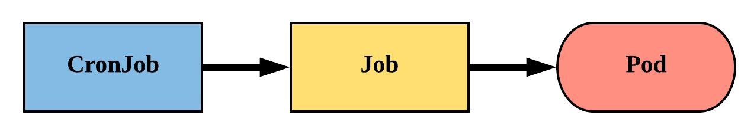
An extension of the Job Controller, it provides a method of executing jobs on a cron-like schedule.
CronJobs within Kubernetes use UTC ONLY.

Slide 227
schedule: The cron schedule for the job.
successfulJobHistoryLimit: The number of successful jobs to retain.
failedJobHistoryLimit: The number of failed jobs to retain.
JobTemplate: Template for the job
apiVersion: batch/v1beta1 kind: CronJob
metadata:
name: mycronjob
spec:
schedule: "*/1 * * * *" successfulJobsHistoryLimit: 3
failedJobsHistoryLimit: 1 jobTemplate:
spec:
completions: 4
parallelism: 2 template:
<pod template>

Slide 228
CronJob Demo Lab

Slide 229
Kubernetes Scheduling

Slide 230
Useful commands..

Slide 231
View the name of the scheduler pod:
$kubectl get pods -n kube-system
Get the information about your scheduler pod events:
$kubectl describe pods [scheduler_pod_name] -n kube-system
View the events in your default namespace:
$kubectl get events
View the events in your kube-system namespace:
$kubectl get events -n kube-system
Delete all the pods in your default namespace:
$kubectl delete pods --all
Watch events as they are appearing in real time:
$kubectl get events -w
View the logs from the scheduler pod:
$kubectl logs [kube_scheduler_pod_name] -n kube-system
The location of a systemd service scheduler pod:
$/var/log/kube-scheduler.log

Slide 232
Taints and Tolerations

Slide 233

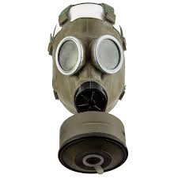
Taint
"contaminate or pollute (a place or something)"
Toleration
"Act of accepting or enduring someone or something unpleasant or disliked"

Slide 234
Taints are configured on NODES
Tolerations are configured on PODS.
Taint(s) restrict pods from being scheduled on a node and will only allow pods having matching toleration(s).
Node01
taint app=web:NoSchedule
Node02
Pod

Slide 235
Toleration does not determine scheduling and force a pod to be scheduled on a node with a matching taint.
A tainted node is removed from the scheduler node selection process unless the pod can tolerate the taint
Node-1
taint app=web:NoSchedule
Node-2
Pod-01
toleration
app=web:NoSchedule

Slide 236
Taints config for Nodes:
$ kubectl taint node <node_name> <key>=<value>:taint_effect
Three types of taint effects:
NoSchedule: pods without toleration will not be scheduled in the node
PreferNoSchedule: will schedule only if no other node available.
NoExecute: Pod without toleration will not be scheduled and evicted if already running on the node.

Slide 237
Toleration configuration in Pod manifest:
Tolerations: <array>
- key: Taint key name to match
operator: Equal (default) or Exists (Any value)
value: Taint Value to match
effect: Taint effect to match
** TolerationSeconds: The amount of time a pod can tolerate the effect of a pod taint before being rescheduled.

Slide 238
Taints and Tolerations
Demo Lab

Slide 239
NodeSelector and NodeName

Slide 240
NodeSelector constrains the nodes a pod has to be scheduled in. It uses the equality based selector to select the node(s) with matching node label(s)
default scheduler
node selector hdd=ssd
node-1
label
hdd=ssd
node-2
label
hd=ssd
node-3

Slide 241
$ kubectl label node node02 node-type=web
node/node02 labeled
apiVersion: v1
kind: Pod
metadata:
name: webpod
spec:
containers:
- name: nginx
image: nginx
nodeSelector:
node-type: web
$ kubectl get po -o wide
webpod 1/1 Running 0 … 10.36.0.8 node02
$ kubectl get events -w
...
default-scheduler Successfully assigned default/webpod to node02

Slide 242
NodeName is manual scheduling…
Allows the user or developer to pick a node by its name for the pod and bypass scheduler
Part of the pod configuration.
apiVersion: v1
kind: Pod
metadata:
name: webpod
spec:
containers:
- name: nginx
image: nginx
nodeName: node-2

Slide 243
apiVersion: v1
kind: Pod
metadata:
name: webpod
spec:
containers:
- name: nginx
image: nginx
nodeName: node-2

Slide 244
NodeSelector and NodeName Demo Lab

Slide 245
Node Affinity

Slide 246

Affinity
(1) an attraction to or liking for something
people with an affinity to darkness
(2) an attractive force between substances or particles that causes them to enter into and remain in chemical combination

Slide 247
address challenge of nodeSelector and its equality based selector type
Same functionality as nodeSelector with expressions based selector type.
Supports various operators for great flexibility to pick nodes:
In, NotIn, Exists, DoesNotExist, Gt, Lt

Slide 248
Two types of affinity:
Hard rule: requiredDuringSchedulingIgnoredDuringExecution
selector has to match a node label to schedule. Existing pods running before the affinity is applied will not be evicted if no affinity. Pods will be in pending state when no node with matching label.
Soft rule：preferredDuringSchedulingIgnoredDuringExecution
Pods will be scheduled to any eligible node if a node with a matching label is not found. Existing pods running before the affinity is applied will not be evicted if no affinity.

Slide 249
nodeAffinity:
type of affinity..node or pod
nodeSelectorTerms:
the list of expressions to match the node labels.
apiVersion: v1
kind: Pod
metadata:
name: affinity-pod
spec:
containers:
- name: nginx
image: nginx
affinity:
nodeAffinity:
requiredDuringSchedulingIgnoredDuringExecution:
nodeSelectorTerms:
- matchExpressions:
- key: app
operator: Exists

Slide 250
nodeAffinity:
type of affinity..node or pod
weight:
value used during the priority scoring to select best node. value from 1 to 100. Does not guarantee node selecting.
preference:
node selector terms associated with the weight.
apiVersion: v1
kind: Pod
metadata:
name: affinity-pod
spec:
containers:
- name: nginx
image: nginx
affinity:
nodeAffinity:
preferredDuringSchedulingIgnoredDuringExecution:
- weight: 1
preference:
matchExpressions:
- key: app
operator: Exists

Slide 251
Node Affinity Demo Lab

Slide 252
Pod Affinity & Pod Anti-Affinity

Slide 253
NodeAffinity: affinity between pod and node
Pod Affinity: Inter-Pod affinity..co-locating pods
Pod anti-Affinity: keeping pods away from each other

Slide 254
Pod Affinity allows you to colocate pods in the same node or topology as other running Pods with matching labels.
This could help improve application performance by co-locating pods of same or dependent application tiers,
Pod anti-affinity is the opposite of the pod Affinity by segregating pods with matching labels.
By default applies only to the same namespace as scheduled but configurable.

Slide 255
TopologyKey defines how pods are co-located..Defined as a node label and could be a node, a rack, an availability zone or a region for example.
some predefined topologyKeys:
kubernetes.io/hostname allows colocating pods on the same node.
failure-domain.beta.kubernetes.io/zone allows colocating pods on the same availability zone.
failure-domain.beta.kubernetes.io/region
...or you can just create your own topologyKey node label.

Slide 256
node01
pod
label: app=nginx
zone=zone2
Pod affinity:
labelSelector:
app=webapp
topologyKey: zone
node02
pod
label: app=webfront
zone=zone1
node03
pod
label: app=webfront
zone=zone1

Slide 257
node01
pod
label: app=nginx
zone=zone2
Pod affinity:
labelSelector:
app=webapp
topologyKey: zone
node02
pod
label: app=webfront
zone=zone1
node03
pod
label: app=webfront
zone=zone1

Slide 258
pod Affinity & Pod Anti-Affinity
Demo Lab

Slide 259
Running Multiple Schedulers

Slide 260
Kubernetes can run custom schedulers along with the default scheduler if it does not your requirement.
Custom scheduler can compiled and built into container images.
A scheduler can be specified in a pod configuration or pod template using the schedulerName field

Slide 261
$kubectl exec kube-scheduler-kube-master -n kube-system --
kube-scheduler -h
https://kubernetes.io/docs/tasks/extend-kubernetes/configure-multiple-schedulers/
system:kube-scheduler
Allows access to the resources required by the scheduler component.
system:volume-scheduler
Allows access to the volume resources required by the kube-scheduler component.

Slide 262
Managing multiple clusters with Kubernetes Contexts

Slide 263
kubectl
username / permission - IAM
minikube
K8s Contexts
context
kubectl config get-context *
user account
minikube
admin
cluster
minikube
kubeadm
namespace
dev
prod

Slide 264
Kubernetes Storage

Slide 265
Pods by themselves are useful but applications need to read and write data using some type of storage. Kubernetes provides multiple types of storage solutions:
Volumes
Persistent Volumes
Persistent Volume Claims
Storage Classes

Slide 266
Understanding the difference between storage units:
Gygabyte GB and Gibibyte Gi..
1 GB is defined as 1000³ bytes whereas 1 GiB is defined as 1024³ bytes.
1 Megabyte (MB) as 1000² bytes whereas 1 Mebibyte (MiB) 1024² bytes
1 Kibibyte (KiB) as 1024 bytes whereas 1 KB as 1000 bytes

Slide 267
Storage Volumes

Slide 268
NODE-01
container web
POD-A
container filesystem
├── web
├── 2012
├── 2333
└── current
Each container in pod has its own filesystem and stores data its in own filesystem
The data is stored as long as the container or the pod is running and is thus considered ephemeral.
data
container webagent
container filesystem
├── webagent
├── var
├── data
└── current
data

Slide 269
NODE-01
container web
POD-A
container filesystem
├── web
├── 2012
├── 2333
└── current
Data cannot be shared between containers that are running within a pod.
There is a need to allow the data to persist and be accessible by all the containers in the pod
data
container webagent
container filesystem
├── webagent
├── var
├── data
└── current
data

Slide 270
NODE-01
container web
POD-A
container filesystem
├── web
├── 2012
├── 2333
└── current
Volumes provide external storage for pods and their containers and allow data to be shared between all containers within a pod.
Kubernetes supports many volume types and part of pod spec.
volumeMount:
/web/2333
VOLUME EmptyDIr:{}
container webagent
container filesystem
├── webagent
├── var
├── data
└── current
volumeMount:
/webagent/data

Slide 271
NODE-01
container web
POD-A
container filesystem
├── web
├── 2012
├── 2333
└── current
VOLUME EmptyDIr:{}
container webagent
container filesystem
├── webagent
├── var
├── data
└── current

Slide 272
NODE-01
container web
POD-A
container filesystem
├── web
├── 2012
├── 2333
└── current
VOLUME HostPath:
path:
/var/web/data
/var/web/data
container webagent
container filesystem
├── webagent
├── var
├── data
└── current

Slide 273
NODE-01
container web
POD-A
container filesystem
├── web
├── 2012
├── 2333
└── current
VOLUME HostPath:
path:
/var/web/data
/var/web/data
container webagent
container filesystem
├── webagent
├── var
├── data
└── current

Slide 274

NODE-n
container web
container filesystem
POD-A
NODE-01
├── web
├── 2012
├── 2333
└── current
Durable
Storage
System
VOLUME web-data
container webagent
container filesystem
├── webagent
├── var
├── data
└── current

Slide 275
Volume Types
awsElasticBlockStore
azureDisk
azureFile
cephfs
configMap
csi
downwardAPI
emptyDir
fc (fibre channel)
flexVolume
flocker
GCEPersistentDisk
glusterfs
hostPath
iscsi
local
nfs
Gitrepo -- deprecated
projected
portworxVolume
quobyte
rbd
scaleIO
secret
storageos
vsphereVolume
emptyDir : simple shared volume for transient data within a pod
hostPath: used for mounting directories from the worker nodes filesystem hosting the pods
configMap, secret, downwardAPI: kubernetes volume types to expose those kubernetes resources to pass data to applications
GCEPersistentDisk: persistent disk to be shared across worker nodes by pods with GKE

Slide 276
Volumes
volumes: (list) Pod level config
volumes to be attached to the Pod.
Every volume within the list must have it’s own unique name. Pod can support multiple types of Volumes.
volumeMounts: (list) Container level config
location in the container file system where the volume is mounted to. Linux allows mounting at any location of the container file system tree.
A volume has to be mounted to a container using volumeMount in order for the container to have access to the volume.
Part of the pod spec and a pod container can mount multiple volumes types defined in the pod spec.

Slide 277
Volumes Demo lab

Slide 278
Persistent Volumes or PVs

Slide 279
Persistent Volumes
Persistent Storage have to be created by users or developers. However, Kubernetes goal is to be a platform which abstracts the underlying infrastructure details in this case storage.
Persistent Volumes or PVs decouple pods from the underlying infrastructure and the external storage systems configuration details.
Persistent volumes are a cluster scoped object

Slide 280
The admin provisions the underlying storage and registers it in K8s using persistent volumes. The admin can create many PVs of various size and access modes as a cluster wide pool of storage.
When users need storage for their pods, they can create a persistent volume claim based on required size and access mode. The API server will then find the best PV match and bind it to the PVC
The PVC can then be used as a type of volume in the pod

Slide 281
Persistent Volume Specification:
capacity.storage: The total amount of available storage.
accessModes: whether the PV can be read by a single node or multiple nodes
Options include:
ReadWriteOnce (RWO) - RW on a single node
ReadOnlyMany (ROM) - RO on multiple nodes
ReadWriteMany (RWM) - RW on multiple nodes
volumeMode:
filesystem: (default) volume mounted into Pods into a directory.
block: device is empty and Kubernetes creates a filesystem on the device before mounting it for the first time.

Slide 282
PersistentVolume
persistentVolumeReclaimPolicy: what to do with the PV once the PersistentVolumeClaim is released
Retain: PV retained (default)
Delete: PV deleted (if supported)
Recycle: PV scrubbed for reuse (if supported)
storageClassName: Optional name of the storage class that PVC’s can reference. If provided, ONLY PVC’s referencing the name consume use it.
Define the storage backing the Persistent Volume like nfs, AWS EBS, GCEPersistentStorage etc..

Slide 283
CLUSTER ADMIN
Persistent
Volume
External
Storage
System
admin creates NAS
admin creates a PV pointing to NAS

Slide 284
CLUSTER ADMIN
USER/DEVELOPER
namespace DEV
External
Storage
System
400GiB
RWO
RWM
ROM
Persistent
Volume
100Gib
RWO
RWM
Persistent
Volume
Claim
100GiB
RWM
Persistent
Volume
100Gib
RWO
Persistent
Volume
100Gib
ROM
RWM
Persistent
Volume
50Gib
RWO
RWM
user creates PVC

Slide 285
USER/DEVELOPER
namespace DEV
CLUSTER ADMIN
Persistent
Volume
Claim
Persistent
Volume
External
Storage
System
API server binds the PVC to PV
user creates PVC
admin creates NAS
admin creates a PV pointing to NAS

Slide 286
USER/DEVELOPER
namespace DEV
CLUSTER ADMIN
POD
Persistent
Volume
Claim
Persistent
Volume
External
Storage
System
volume
user creates PVC
user creates a pod with volume pointing to PVC
admin creates NAS
admin creates a PV pointing to NAS

Slide 287
Persistent Volumes or PVs
Demo Lab

Slide 288
Persistent Volume Claims or PVCs

Slide 289
PersistentVolumeClaims
PersistentVolumeClaims (PVC) are a namespaced
request for storage created by the users.
Satisfies a set of requirements instead of mapping to a storage resource directly. PVC is used as pod volume.
Ensures that an application’s ‘claim’ for storage is portable across numerous durable storage providers.
Every PVC is automatically bound to a Persistent Volume by Kubernetes based on the claim requirements.

Slide 290
USER/DEVELOPER
namespace DEV
CLUSTER ADMIN
POD
Persistent
Volume
Claim
frontend
Persistent
Volume
100Gb
ROM
External
Storage
System
volume
POD
Persistent
Volume
Claim
backend
Persistent
Volume
10Gb
RWO
External
Storage
System
volume

Slide 291
PersistentVolumeClaim
accessModes: The selected method of accessing the storage. This MUST be a subset of what is defined on the target PV or Storage Class.
ReadWriteOnce
ReadOnlyMany
ReadWriteMany
resources.requests.storage: The desired amount of storage for the claim
storageClassName: The name of the desired Storage Class

Slide 292
PVs and PVCs with Selectors
kind: PersistentVolume apiVersion: v1 metadata:
name: pv-selector-example labels:
type: hostpath spec:
capacity: storage: 2Gi
accessModes:
- ReadWriteMany hostPath:
path: "/mnt/data"
kind: PersistentVolumeClaim apiVersion: v1
metadata:
name: pvc-selector-example spec:
accessModes:
- ReadWriteMany resources:
requests: storage: 1Gi
selector: matchLabels:
type: hostpath

Slide 293
PV Phases
Available
PV is ready and available to be consumed.
Bound
The PV has been bound to a claim.
Released
The binding PVC has been deleted, and the PV is pending reclamation.
Failed
An error has been encountered attempting to reclaim the PV.

Slide 294
PersistentVolumeClaim Demo Lab

Slide 295
NOTE: if we delete pvc while in use by pod the pvc will still show as bound to the pv to prevent data loss. This is caused by a storage object called data loss and user protection. It will prevent pvc to removed by accident or while used as a volume by a pod.
It is visible in the Finalizers field on the kubectl describe pvc and pv outputs.

Slide 296
Storage Classes

Slide 297
Persistent Volumes are great by abstracting the underlying storage details from the developer or the user
It is however still a manual process that requires the cluster admin to pre-provision all the Persistent Volumes…

Slide 298
Storage classes is a cluster scoped kubernetes resource that enables the dynamic provisioning of persistent volumes and the underlying storage system using provisioner plugins.
the admin can create one or more storage class based on supported external durable storage. PVs will be automatically created based on the PVC requests.

Slide 299
StorageClasses supports following storage systems:
AWSElasticBlockStore
AzureFile
AzureDisk
CephFS
Cinder
FC
FlexVolume
Flocker
GCEPersistentDisk
Glusterfs
iSCSI
PhotonPersistentDisk
Quobyte
NFS
RBD
VsphereVolume
PortworxVolume
ScaleIO
StorageOS
Local

Slide 300
StorageClass
provisioner: Defines the volume plugin to be used for provisioning the Persistent Volume based on the underlying storage system and kubernetes cluster type.
https://kubernetes.io/docs/concepts/storage/storage-classes/
parameters: various parameters specific to the provisioner used like disk type, zone, name of the volume, etc..
reclaimPolicy: The behaviour for the backing storage when the PVC is deleted.
Retain - manual clean-up
Delete - pv and underlying storage deleted

Slide 301
StorageClass
Support for expanding PersistentVolumeClaims (PVCs) is now enabled by default and with the following types of volumes:
gcePersistentDisk
awsElasticBlockStore
Cinder
glusterfs
rbd
Azure File
Azure Disk
Portworx
FlexVolumes
CSI
You can only expand a PVC if its storage class during runtime when allowVolumeExpansion field is set to true.

Slide 302
CLUSTER ADMIN
Persistent
Volume
Provisioner
storage class
GOLD
admin creates a Storage Class that reference a Persistent Volume Provisioner

Slide 303
USER/DEVELOPER
namespace DEV
CLUSTER ADMIN
Persistent
Volume
Claim
storage class
GOLD
Persistent
Volume
Provisioner
user creates s PVC which reference the storage class GOLD

Slide 304
USER/DEVELOPER
namespace DEV
CLUSTER ADMIN
External
Storage
System
Persistent
Volume
Claim
storage class
GOLD
Persistent
Volume
Provisioner
Persistent
Volume
kubernetes checks the storage class and PV provisioner creates a PV backed by the an actual storage

Slide 305
USER/DEVELOPER
namespace DEV
CLUSTER ADMIN
External
Storage
System
storage class
GOLD
Persistent
Volume
Provisioner
Persistent
Volume
Claim
Persistent
Volume
K8s binds the PVC to PV

Slide 306
USER/DEVELOPER
namespace DEV
CLUSTER ADMIN
External
Storage
System
storage class
GOLD
Persistent
Volume
Provisioner
POD
Persistent
Volume
Claim
volume
Persistent
Volume
K8s binds the PVC to PV
user creates Pod with Volume referencing the PVC

Slide 307
Storage Class Demo Lab

Slide 308
Configuring Applications

Slide 309
To configure your application, "generally speaking", is to configure the parameters in the application program.
Application configuration can be used to decouple these parameters from the application source code..
Adding configuration data to your code or to the Dockerfile would mean refactoring of the code of the app or the container.
...not to mention the security risk with the dockerfile exposing confidential data.

Slide 310
Three ways to pass configuration data to an application:
setting environment variables
command-line arguments
config file using some type of volume

Slide 311
Commands and args

Slide 312
Command and args allow you to pass config data to an application via the command line arguments..Executing commands in a Docker container require the command and its arguments.
The command being the executable or a file that contains the program and arguments are the values passed on to your program during its execution.
They are defined in the Dockerfile using the ENTRYPOINT and CMD.
ENTRYPOINT == the command or executable
CMD == the arguments
docker run <image> <arguments>

Slide 313
In Kubernetes and the pod configuration, command and args are the equivalent of ENTRYPOINT and CMD respectively.
ENTRYPOINT == command
CMD == args
command and args are an array or list data type and cannot be changed once the pod is created.
Overriding the command and args of a docker container
apiVersion: v1
kind: Pod
metadata:
name: my-pod
spec:
containers:
- name: cka
image: deanj08/appdata
command: ["/bin/<command>"]
args:
- argument#1
- argument#2
….
- argument#n

Slide 314
Environment Variables

Slide 315
Setting environment variables in the code will vary accross the various runtimes
In python it would be
os.environ['VARIABLE']
import os
home_dir =os.environ['HOME']
username = os.environ['USER']
print(f'{username} home directory is {home_dir}')
In Node.js
process.env.VARIABLE

Slide 316
Environment variables are defined in the env field of the pod spec to pass config data to application.
Environment variables cannot be changed once a pod is created. If they are credentials then they would be exposed to anyone reading the pod manifest which is bad!!
This creates a challenges as any change to the env variables defined will require a new manifest for each pod and cause potential security breach.
Need to decouple the app config from the pod spec.

Slide 317
ConfigMaps

Slide 318
ConfigMap is a Kubernetes namespaced resource to store data in a map of key:value pairs
Decouples the environment specific config data from the container image and the pod definition file. Makes the application portable across many environment
Users can keep the same pod manifest across multiple environments for development, testing and production though the application config may change.

Slide 319
The name of a ConfigMap must be a valid DNS subdomain name.
ConfigMap: App configuration data
KEY: name of the environment variable in the application code
VALUE: value of that environment variable
POD
containerized
application

Slide 320
ConfigMaps can be created from:
a manifest:
apiVersion: v1
kind: ConfigMap
metadata:
name: cm1
data:
LAB: env-var
USER: John
data: map of key:value pairs with the key being the name of one environment variable entry.

Slide 321
cm is shorthand for configmap
literals:
$ kubectl create cm <name> --from-literal=key=value
files:
$ kubectl create cm <name> --from-file=key=<file_path>
$ kubectl create cm <name> --from-env-file=<file_path>
directories:
$ kubectl create cm <name> --from-file=<dir path>

Slide 322
ConfigMaps can be referenced in a pod manifest through several different means :
Passing one configmap entry as environment variables using env
Passing all configmap entry as environment variables using envFrom
as command-line arguments referencing env variables with args.
As a volume mounted to a pod container using the configMap volume type.

Slide 323
ConfigMaps Demo Lab

Slide 324
Secrets

Slide 325
Secret
Secrets is a kubernetes resources to pass sensitive data to applications such as credentials or certificates using:
environment variables
volume (recommended)
Same functionality as ConfigMap. difference is that the data is encoded with base64.
Base64 encoding used as data may contain binary content such as TLS certificates. Not for security purposes.

Slide 326
Secrets can be encrypted at rest in the etcd with the EncryptionConfiguration kubernetes object. more details at:
https://kubernetes.io/docs/tasks/administer-cluster/encrypt-data/
secrets are stored in in-memory filesystem or tmpfs and not in disk.
$ k exec posec2 -- mount | grep creds
tmpfs on /home/creds type tmpfs (ro,relatime)
With the mount option relatime, the access time (atime) will not be written to the disc during every access

Slide 327
Secret
type: Three types of secrets:
docker-registry: Docker Hub credentials
generic/Opaque: unstructured data
tls - certificate based secret
stringData: plain-text
non binary
key:value pairs - write only
data: map of key-value pairs encoded with base64
echo -n "password" | base64
echo -n "base64password" | base64 --decode
apiVersion:v1 kind: Secret metadata:
name: sec1
type: Opaque
data:
username: AXhhbXBsZQ$= password: xnMJKHXNzd29=

Slide 328
Secrets Demo lab

Slide 329
Kubernetes Security

Slide 330
TLS Certificates Demystified

Slide 331
Secret
What is Encryption?
scrambling of data using ciphers so it cannot be read if intercepted. A private key used for encryption.
What is a private key?
private key is using to encrypt and decrypt. must be in possession of anyone wanting to read the encrypted data
why do we need encryption?
with the internet and the exchange of data over a public network, there is a need to encrypt all data exchanged over the internet.

Slide 332
Secret
What is symmetric encryption?
using only a private key to encrypt and decrypt the data exchanged between 2 parties.
meaning that in the days of the internet, the private key has to be transferred over the network with risk of hijacking. need for something new?
The secure alternative: asymmetric encryption:
using a private key kept securely and a public key.
public key is publicly available and does the encryption, however only the private key can do the decryption.

Slide 333
Secret
So how to manage these keys to encrypt/decrypt data?? The PKI or Public Key Infrastructure:
Public Key Infrastructure, refers to the entire trust model that facilitates public key encryption

Slide 334
K8s Components secure Communication

Slide 335
Authentication and Access Control

Slide 336
What is Kubernetes Authentication?
Validating the identity of a user requesting access to a Kubernetes cluster.
This validation is done by the API server for ALL authentication requests.

Slide 337

Secret
User Identity
Who are you? Username
Do you have ID?? UID
Any other credentials to verify who you really are???
GROUP

Slide 338
User Credentials Created and Managed externally
TLS Certificate
static password file
HTTP auth
Bearer Token
Third Party auth : Google, LDAP, SAML etc..
API SERVER
Auth Request

Slide 339

Secret
TWO TYPES OF USERS in Kubernetes
NON-HUMANS
PODS/Applications
HUMANS

Slide 340
Secret
Human users identity is created and managed externally. No kubernetes API object. Not namespaced.
Pods identity is created using a Kubernetes resource or service accounts. The serviceAccount represent the identity of a Pod and its application. Namespaced.
Users in Kubernetes are just strings!

Slide 341
Secret
GROUPS ...just strings Representing an arbitrary name given by the user
Allows assigning permissions to the group instead of adding permission to each user. users can be added to one or more groups.
Permissions determine which operations a user is allowed to perform and what resources the user is allowed to access

Slide 342
Secret
There are other k8s groups with special function:
system:authenticated
all successfully authenticated users
system:unauthenticated
anonymous users ..not authenticated
system:serviceaccounts ...all service accounts
system:serviceaccounts:<namespace> ..sa for a namespace

Slide 343
API server will use one or more authentication plugin to authenticate a user request:
TLS certificate (X509)
password files
Bearer Tokens
third party (SAML,SSO,LDAP etc..)
anonymous
The cluster admin manages which auth plugins are used by the API server. less is better
command line configuration using --flags in the API server configuration when deployed whether as service or pod.

Slide 344
--anonymous-auth Default: true
Enables anonymous requests to the secure port of the API server.
--authentication-token-webhook-config-file stringFile
with webhook configuration for token authentication in kubeconfig format. The API server will query the remote service to determine authentication for bearer tokens.
--token-auth-file string
the file that will be used to secure the secure port of the API server via token authentication.
https://kubernetes.io/docs/reference/command-line-tools-reference/kube-apiserver

Slide 345
Secret
authentication
plugin
TLS Cert
authentication
plugin
username
password
API SERVER

Slide 346
Secret
authentication
plugin #1
TLS cert
if valid cert then extract:
USERNAME/UID
GROUP
authentication
plugin #2
username
password
API SERVER

Slide 347
$ openssl x509 -in admin.crt -text -noout
Certificate:
Data:
Version: 3 (0x2)
Serial Number: 3641009292096652108 (0x328776a90751434c)
Signature Algorithm: sha256WithRSAEncryption
Issuer: CN = kubernetes
Validity
Not Before: Oct 25 11:14:05 2020 GMT
Not After : Oct 25 11:14:06 2021 GMT
Subject: O = system:masters, CN = admin
Subject Public Key Info:
…….

Slide 348
Secret
authentication
plugin
TLS Cert
USERNAME
UID
GROUP
authentication
plugin
Token
authorization
USERS
API SERVER

Slide 349
Service Accounts

Slide 350
Secret
The Service Account is a namespaced Kubernetes resource represent the identity of a pod and its application
Enables applications running in pods to be authenticated and authorized by the API server
a service account can be referred by many pods but a pod can only be associated with one service account in its namespace
The service account controls which resource a pod has access to and the type of operation it can perform

Slide 351
Secret
Default service account created automatically created in each namespace.
Used by Pods to authenticate with the API server. An API token is generated at the creation of the service account and stored in a secret volume mounted on the container(s) filesystem.
Uses JSON web tokens

Slide 352
JWT Token
{
"iss": "kubernetes/serviceaccount",
"kubernetes.io/serviceaccount/namespace": "default",
"kubernetes.io/serviceaccount/secret.name": "default-token-kf6sv",
"kubernetes.io/serviceaccount/service-account.name": "default",
"kubernetes.io/serviceaccount/service-account.uid": "9032cf97-1b0d-40f2-a4a7-17428cfba438",
"sub": "system:serviceaccount:default:default"
}

Slide 353
Secret
imperatively:
$kubectl create sa appsec
declaratively:
secrets:
array - name of secret for
for additional API tokens
imagePullSecrets:
array - allows all pods using this
service account to use the docker
registry secret. no need to
configure at the pod level.
apiVersion: v1
kind: ServiceAccount
metadata:
name: sa1
secrets:
- name: appsec
imagePullSecrets:
- name: reg1

Slide 354
Secret
service accounts are assigned to pods using the pod manifest:
serviceAccountName: name of the
service account to be used by
the pod. Cannot be changed after
pod is created.
uses default service account
if not set.
apiVersion: v1
kind: Pod
metadata:
name: webapp
spec:
serviceAccountName: sa1
containers:
- name: nginx
image: nginx

Slide 355
Kubernetes Authorization Overview

Slide 356
Authorization is a process of giving a user permission to access a specific resource(s) or function(s).

Slide 357
Gives permissions to user over which operations each user or group of users can execute in namespaces or cluster wide.
Have full control over which operations each process inside a pod can execute.
Limit the visibility of certain resources of namespaces.

Slide 358
Role Based Access Controls or RBAC

Slide 359
Secret
Authorization is done in Kubernetes using plugings
Node authorization is used internally to authorize kubelet’s API calls
RBAC
ABAC is based on a static config file and is considered insecure
WebHook is an external service such Google that the Kubernetes API can call

Slide 360
Secret
Role Based Access Controls or RBAC defines what actions a user can perform in a Kubernetes cluster.
users can be human, machine or groups and are called Subjects and their permissions are defined in a role.
The standard authorization plugin for the API Server
Enabled at the API server command line with the flag:
--authorization-modes: RBAC,Node

Slide 361
RBAC == KUBERNETES Grammar
Subjects: users
Verbs: The set of actions or operations that can be executed to resources. Request verbs represent actions ie: create, get, list,watch, delete, etc.) are CRUD operations in the API server.
Resources: Kubernetes API Objects in a cluster. Pods, Deployments, Services, Nodes, ReplicaSets, PersistentVolumes etc..

Slide 362
VERBS:
https://kubernetes.io/docs/reference/access-authn-authz/authorization/
HTTP verb | request verb
POST | create
GET, HEAD | get (for individual resources), list (for collections, including full object content), watch (for watching an individual resource or collection of resources)
PUT | update
PATCH | patch
DELETE | delete (for individual resources), deletecollection (for collections)

Slide 363
SUBJECTS
VERBS
RESOURCES
CREATE
GET
LIST
WATCH
UPDATE
PATCH
DELETE
PODS
REPLICASETS
DEPLOYMENTS
VOLUMES
SERVICEACCOUNTS
DAEMONSETS
JOBS
SERVICES
NODES
GROUP

Slide 364
SUBJECTS
VERBS
RESOURCES
CREATE
GET
LIST
WATCH
UPDATE
PATCH
DELETE
PODS
REPLICASETS
DEPLOYMENTS
VOLUMES
SERVICEACCOUNTS
DAEMONSETS
JOBS
SERVICES
NODES
GROUP

Slide 365
Secret
RBAC is composed of four Kubernetes API objects:
Roles and ClusterRoles:
define permitted request Verbs on resources. They can be reused for different subjects. namespaced resource. For cluster-wide scoping, the equivalent API object is called ClusterRoles.
RoleBindings and ClusterRoleBindings:
Associates roles with subjects. Namespaced.
For cluster-level scoping, non-namespaced equivalent, there is ClusterRoleBindings though roleBindings can be associated with ClusterRoles.

Slide 366
USERS OR SUBJECTS
roleBinding
role
- verbs
- resources
GROUP

Slide 367
Using Roles and RoleBindings

Slide 368
Secret
Roles defines what action a client can perform of which resource(s) within a namespace. Actions are based on HTTP verbs.
Roles can be created declaratively with a manifest
apiVersion: rbac.authorization.k8s.io/v1
kind: Role
metadata:
name: role1
namespace: dev
rules:
- apiGroups: [""]
verbs: ["get","list"]
resources: ["services"]
apiGroups: name of api group. a rule per apiGroup.
verbs: list of verbs defining actions allowed
resources: resources the rule applies to. have to be plural
resourceNames: list of name of the specific resource instance that the rule applies to.

Slide 369
Roles can be create imperatively using the
$kubectl create role command
Once created a role needed to binded to a service account or a user or a group using roleBinding.
$ kubectl create rolebinding rb1 --role=role1 --serviceaccount=dev:default -n dev
rolebinding.rbac.authorization.k8s.io/rb1 created
kubectl create role role1 --verb=list --verb=get --resource=services -n dev
role.rbac.authorization.k8s.io/role1 created

Slide 370
apiVersion: rbac.authorization.k8s.io/v1
kind: RoleBinding
metadata:
name: rb1
namespace: dev
….
roleRef:
apiGroup: rbac.authorization.k8s.io
kind: Role
name: role1
subjects:
- kind: ServiceAccount
name: default
namespace: dev
roleRef: Only one role can be associated with the role binding
subjects: a role binding can be associated with one or more service account or users or groups.
namespaces: roleBindings can be referred by service accounts or groups from other namespaces

Slide 371
qa
role binding
resources
dev
role binding
role
(verbs)
service
account
groups
resources

Slide 372
qa
role binding
resources
dev
role binding
role
service
account
groups
resources

Slide 373
qa
service
account
role binding
dev
service
account
role binding
role
groups
resources

Slide 374
qa
service
account
dev
service
account
role binding
role
groups
resources

Slide 375
qa
service
account
dev
service
account
role binding
role
groups
resources

Slide 376
Roles and RoleBindings Demo Lab

Slide 377
Using ClusterRoles and ClusterRoleBindings

Slide 378
Secret
Cluster roles define permissions on resources.
namespaced scoped resources
cluster level scoped resources
non resource URLs like /api and /healthz.
clusterRoleBinding links a user or group or service account to a cluster role to give them permissions to resource at cluster level.
There are default clusterRoles and clusterRoleBindings:
$ kubectl get clusterroles $kubectl get clusterrolebindings
## The clusterRole system:discovery used for non resource URLs

Slide 379
declarative approach
apiGroups: name of api group. a rule per api group type.
verbs: list of verbs defining actions allowed to be performed by client
resources: resources the rule applies to. have to be plural
resourceNames: list of name of the specific resource instance that the rule applies to.
apiVersion: rbac.authorization.k8s.io/v1
kind: ClusterRole
metadata:
name: clusrole1
rules:
- apiGroups: [""]
verbs: ["get","list"]
resources: ["services", "configmaps"]
- apiGroups: ["apps"]
verbs: ["get","list"]
resources: ["deployments"]

Slide 380
Secret
a clusterRoleBinding can reference a cluster role to give permissions to users to perform actions on resources in all namespaces.
a RoleBinding can reference a cluster role to give permissions to a user to perform actions on resources in the same namespace as the rolebinding.
a clusterRoleBinding cannot reference a role

Slide 381
creating a clusterRole:
$kubectl create clusterrole boss1 --verb=list --verb=get --resource=peristentvolumes --resource=services --resource=pods
clusterrole.rbac.authorization.k8s.io/boss1 created
binding a clusterRole with a service account using a roleBinding:
$kubectl create rolebinding cbind1 --clusterrole=boss1 --serviceaccount=dev:default -n dev
rolebinding.rbac.authorization.k8s.io/cbind1 created
binding a clusterRole with a service account using a clusterRoleBinding:
$kubectl create clusterrolebinding cbind1 --clusterrole=boss1 --serviceaccount=dev:default
rolebinding.rbac.authorization.k8s.io/cbind1 created

Slide 382
Cluster-level
ClusterRole
cluster scoped
resources
clusterRoleBinding
DEV namespace
QA namespace
service
account
resources
resources
roleBinding

Slide 383
Cluster-level
cluster scoped
resources
clusterRoleBinding
ClusterRole
DEV
QA
service
account
resources
resources
roleBinding

Slide 384
Cluster-level
cluster scoped
resources
clusterRoleBinding
ClusterRole
dev
dev
service
account
resources
resources
roleBinding

Slide 385
Cluster-level
cluster scoped
resources
clusterRoleBinding
ClusterRole
dev
qa
service
account
resources
resources
roleBinding

Slide 386
Cluster-level
cluster scoped
resources
clusterRoleBinding
ClusterRole
namespace:dev
namespace:qa
service
account
resources
roleBinding
resources

Slide 387
Cluster-level
ClusterRole
cluster scoped
resources
clusterRoleBinding
namespace:dev
namespace:qa
Role
service
account
resources
roleBinding
resources

Slide 388
ClusterRoles and ClusterRoleBindings Demo Lab

Slide 389
Security Contexts

Slide 390
Secret
What are Security Contexts?
in a nutshell…..Pod level security
Manages access rights, privileges and permissions for processes and filesystems.
Why?
Pods and containers within them are the atomic level resource to host an application. Need to protect each applications from the many attack vectors.

Slide 391
Secret
Two types of Security Contexts
Pod level security context
security constraints applied to all containers in the pod
Container level security context
security constraints applied on a per container basis. Override Pod level security context.

Slide 392
Secret
By default containers run as root with uid = 0
$ k exec appsec -- id
uid=0(root) gid=0(root) groups=0(root)
RISK: if container image is malicious, it will be able to execute its malicious code in that image.
Security contexts allow to set a pod or its container(s) to a user ID other than 0. UID is not a username. container set UID takes precedence over pod

Slide 393
Security contexts are configured in a pod manifest
apiVersion: v1
kind: Pod
metadata:
name: poscc3
spec:
securityContext:
runAsUser: 100
containers:
- name: scc1
image: deanj08/secrets
securityContext:
runAsUser: 1000
securityContext: specify a user ID - container UID takes precedence.
runAsNonRoot: container run as non root user
$kubectl exec poscc3 -- id
uid=1000 gid=0(root) groups=0(root)

Slide 394
Secret
fsgroup controls access to shared volumes by containers in a pod. Allows to set the Group ID or GID. A container GID must match the shared storage group ID to have access to that volume.
Control each process privilege ..you can set a container to privileged mode to have access to more kernel capabilities under /dev (Privileged or kernel mode is the processing mode that allows code to have direct access to all hardware and memory in the system)

Slide 395
Assigns permissions to containers..you can add or drop specific capabilities at the container level like configuring the date and time or allow a system to reboot.
https://github.com/torvalds/linux/blob/master/include/uapi/linux/capability.h under "/*** POSIX-draft defined capabilities"
Prevent a container from writing to the container filesystem… readOnlyFileSystem

Slide 396
Network Policies

Slide 397
Secret
NetworkPolicy is a Namespaced Kubernetes resource
For all y'all network folks out there
Network Policies == Kubernetes Network Access Lists
All traffic is allowed between Pods by Default in a namespace
Provides the Pod network with access control for inter POD traffic.

Slide 398
Secret
Application of network policies uses Selectors in combination with Labels
CNI support needed for Network Policies to take effect
Network access control to Pods configured with Ingress and Egress Rules
Rules are ORed and not ANDed.
Ingress rule != Ingress service

Slide 399
Secret
All traffic is denied with selector is empty. All ingress or egress inter Pod traffic denied rules are empty. Rules are only ALLOW
apiVersion: networking.k8s.io/v1
kind: NetworkPolicy
metadata:
name: netpol1
spec:
podSelector:{}
ingress: []
egress: []
podSelector: selects pod with matching labels to apply networkPolicy - {map}
ingress/egress: Allow connections to pod with matching selector label.
[array]

Slide 400
Three levels of network isolation with ingress rules :
between Pods
between Namespaces
between IP blocks using CIDR notation
INGRESS rules

Slide 401
namespace=PROD
pod frontend
app=frontend
pod backend
app=backend
x
pod webapp
app=nginx

Slide 402
Secret
Allowing only Pod traffic from frontend pod to backend pod
apiVersion: networking.k8s.io/v1
kind: NetworkPolicy
metadata:
name: netpol1
spec:
podSelector:
matchLabels:
app: backend
ingress:
- from:
- podSelector:
matchLabels:
app: frontend

Slide 403
Secret
Restricting the allowed traffic at the containerPort level:
apiVersion: networking.k8s.io/v1
...
spec:
podSelector:
matchLabels:
app: backend
ingress:
- from:
- podSelector:
matchLabels:
app: frontend
ports:
- port: 3090
ports: allow traffic to containerPort equal to 3090
even when using a service, it will use the container port and not the service port.

Slide 404
namespace=PROD
pod orderapp
app=frontend
**connect to port=3200
pod testapp
app=frontend
connect to port=3090
pod orderapp
app=backend
port=3090
x
pod webapp
app=nginx
**connect to port=3090
x

Slide 405
Secret
Allowing traffic from other namespaces
apiVersion: networking.k8s.io/v1
...
spec:
podSelector:
matchLabels:
app: backend
ingress:
- from:
- namespaceSelector:
matchLabels:
tenant: web
- namespaceSelector:
matchLabels:
tenant: dev
podSelector: selects pods in current namespace labelled as app=backend
namespaceSelector: allows traffic from
pods of namespaces labelled tenant: web

Slide 406
namespace:web
tier=prod
namespace=prod
networkPolicy selector:
app=backend
namespace=dev
tier=prod
pods
pod orderapp
app=backend
pods
pods
pods
pods
x
other namespaces

Slide 407
Secret
Allowing traffic from IP blocks using CIDR
apiVersion: networking.k8s.io/v1
...
spec:
podSelector:
matchLabels:
app: backend
ingress:
- from:
- Selector:
ipBlock:
cidr: 172.20.1.0/24
ipBlock: allow traffic from pods in subnet of 172.20.1.0/24 ip block.

Slide 408
Secret
Restrict egress traffic to certain pods
apiVersion: networking.k8s.io/v1
...
spec:
podSelector:
matchLabels:
app: backend
egress:
- to:
- podSelector:
matchLabels:
app: webapp
egress: allow outbound traffic only to pods with label app:webapp

Slide 409
Network Policies Demo Lab

Slide 410
The KUBECONFIG file

Slide 411

The kubectl command is used to manage the cluster and needs to be authenticated with the API Server
Need to add following to the kubectl command every time:
-- central authority certificate
-- client certificate
-- client key
-- server (api server address:port)

Slide 412

Solution...
KUBECONFIG file
- central authority certificate of the cluster
- client certificate
- client key
- server (cluster API-server IP address and port)

Slide 413
The KUBECONFIG contains the following information about:
users (Human, Serviceaccount, Group)
clusters
contexts (context of the user authentication request)
namespaces

Slide 414
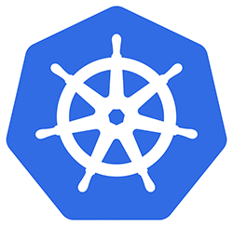
USER
namespace

Slide 415
Kubectl Authentication Context
context
USER X
(namespace)

Slide 416
context A
USER A
(namespace)
context B
USER B
(namespace)

Slide 417
kubectl looks for the the KUBECONFIG file as follow:
By default, the "config" file in the $HOME/.kube directory
the --kubeconfig flag
set a KUBECONFIG environment variable
Note: The current context being the context used is set by the $kubectl config use-context command

Slide 418
Creating a KUBECONFIG file from scratch and mastering the kubectl config command.

Slide 419
create service account
get token of service account
Create role and link role to service account
get certificate authority data and server address from kubeconfig file
create new kubeconfig file using kubectl config command at $HOME/.kube directory
use the context for this user for the cluster.

Slide 420
Certificate Signing Requests Demo Lab

Slide 421
Kubernetes Networking

Slide 422
Kubernetes Networking Fundamentals

Slide 423
Fundamental Networking Rules
A Node is an Kubernetes API object that has one network interface and an address pool called podCIDR. It is the Host or Root Linux network namespace
A Pod is an Kubernetes API object that has one network interface eth0 with a single IP. It has its own Linux network namespace

Slide 424
Fundamental Networking Rules
All containers within a pod can communicate with each other unimpeded.
All Pods can communicate with all other Pods without NAT.
All nodes can communicate with all Pods (and vice-versa) without NAT.
The IP that a Pod sees itself as is the same IP that others see it as.

Slide 425
Container-to-Container
Containers within a pod exist within the same network namespace and share an IP.
Enables intrapod communication over localhost.
Pod-to-Pod
Allocated cluster unique IP for the duration of its life cycle.
Pods themselves are fundamentally ephemeral.

Slide 426
Pod-to-Service
managed by kube-proxy and given a persistent cluster unique IP
exists beyond a Pod’s lifecycle.
External-to-Service
Handled by kube-proxy.
Works in cooperation with a cloud provider or other external entity (load balancer).

Slide 427
Foundation :: Linux Networking Namespaces

Slide 428
A Linux network namespace is an isolated network environment running on a host or a VM that provides a logical networking stack with its own interfaces, routing tables, arp tables, firewall rules..
Each running process communicates within a network namespace
a network namespace or netns provides a brand new network stack for all processes...Used in Mininet, Docker, Kubernetes, Openstack etc..

Slide 429
By convention a named network namespace is an object at /var/run/netns/NAME where the NAME refers to the specified network namespace. This is how a network namespace can persist without having a process associated with it.
By default, Linux assigns every process to the ROOT network namespace to provide access to the external world which is a VM or a node in a Kubernetes cluster

Slide 430
netns
web
netns
db
VM
veth devices
eth0-w
eth0-d
ROOT
netns
192.168.50.101
enp0s8

Slide 431
VM
network namespace
web / 10.1.0.1
network
namespace
db / 10.1.0.2
eth0-w
eth0-d
veth device pair
aka network pipe
ROOT
netns
enp0s8
192.168.50.101

Slide 432
a
VM
network namespace
web 10.1.0.1
network
namespace
db 10.1.0.2
eth0-w
eth0-d
OVS vswitch
ROOT
netns
enp0s8
192.168.50.101

Slide 433
VM
network namespace
web
network
namespace
db
eth0-w
eth0-d
veth10
veth11
OVS vswitch
ovs0 10.1.0.254
ROOT
netns
enp0s8
192.168.50.101

Slide 434
network namespace
web/ 10.1.0.1
network
namespace
db/ 10.1.0.2
eth0-w
eth0-d
veth10
veth11
OVS vswitch
ovs0 10.1.0.254
ROOT
netns
enp0s8
192.168.50.101

Slide 435
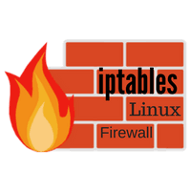
network namespace
web/ 10.1.0.1
network
namespace
db/ 10.1.0.2
eth0-w
eth0-d
veth10
veth11
OVS vswitch
ROOT
netns
enp0s8
192.168.50.101

Slide 436
Foundation :: Linux Networking Namespaces Demo Lab

Slide 437
#multi node connectivity
ip route add <to-br-subnet> via <to-node-ip> dev <vm_if>
#Configure the Linux kernel to allow IP forwarding (disabled by default)
sysctl -w net.ipv4.ip_forward=1
#connect private subnet to the internet
iptables -t nat -A POSTROUTING -s <src_subnet> -j MASQUERADE
https://www.karlrupp.net/en/computer/nat_tutorial
https://man7.org/linux/man-pages/man1/nsenter.1.html

Slide 438
Foundation :: Container Networking

Slide 439
"there is no such thing as container networking"
Kelsey Hightower

Slide 440
Docker containers provide isolation from the Host for the process running in them.
They use network namespaces to provide network stack isolation from the host.
Each container is created in its own network namespace.

Slide 441
Docker networking is a plugable architectures with 3 main drivers: bridge, host and none (no network)..
Default is bridge mode with docker0 and allows containers communication within the same host Docker allocates a block of IPs (172.17.0.0/16 by default)
Communication between containers on different hosts to be solved by Kubernetes, Swarm or overlay networks

Slide 442

HOST
netns CON2
netns CON2
eth0
eth0
veth10
Docker0
172.17.0.1
veth11
ROOT
netns
enp0s8
192.168.50.101

Slide 443

Understanding the
CNI or container network interface

Slide 444
CNCF Project
stands for container runtime interface
started part of Rkt from CoreOS..
Vendor neutral protocol that interfaces between the container runtime and a network provider. not tied to Kubernetes...

Slide 445
container is a Linux network namespace. What unit this corresponds to depends on a particular container runtime implementation..in k8s, pods..
network refers to a group of entities that are uniquely addressable that can communicate amongst each other. in K8s entities will be pods and their unique address will be their IP.

Slide 446
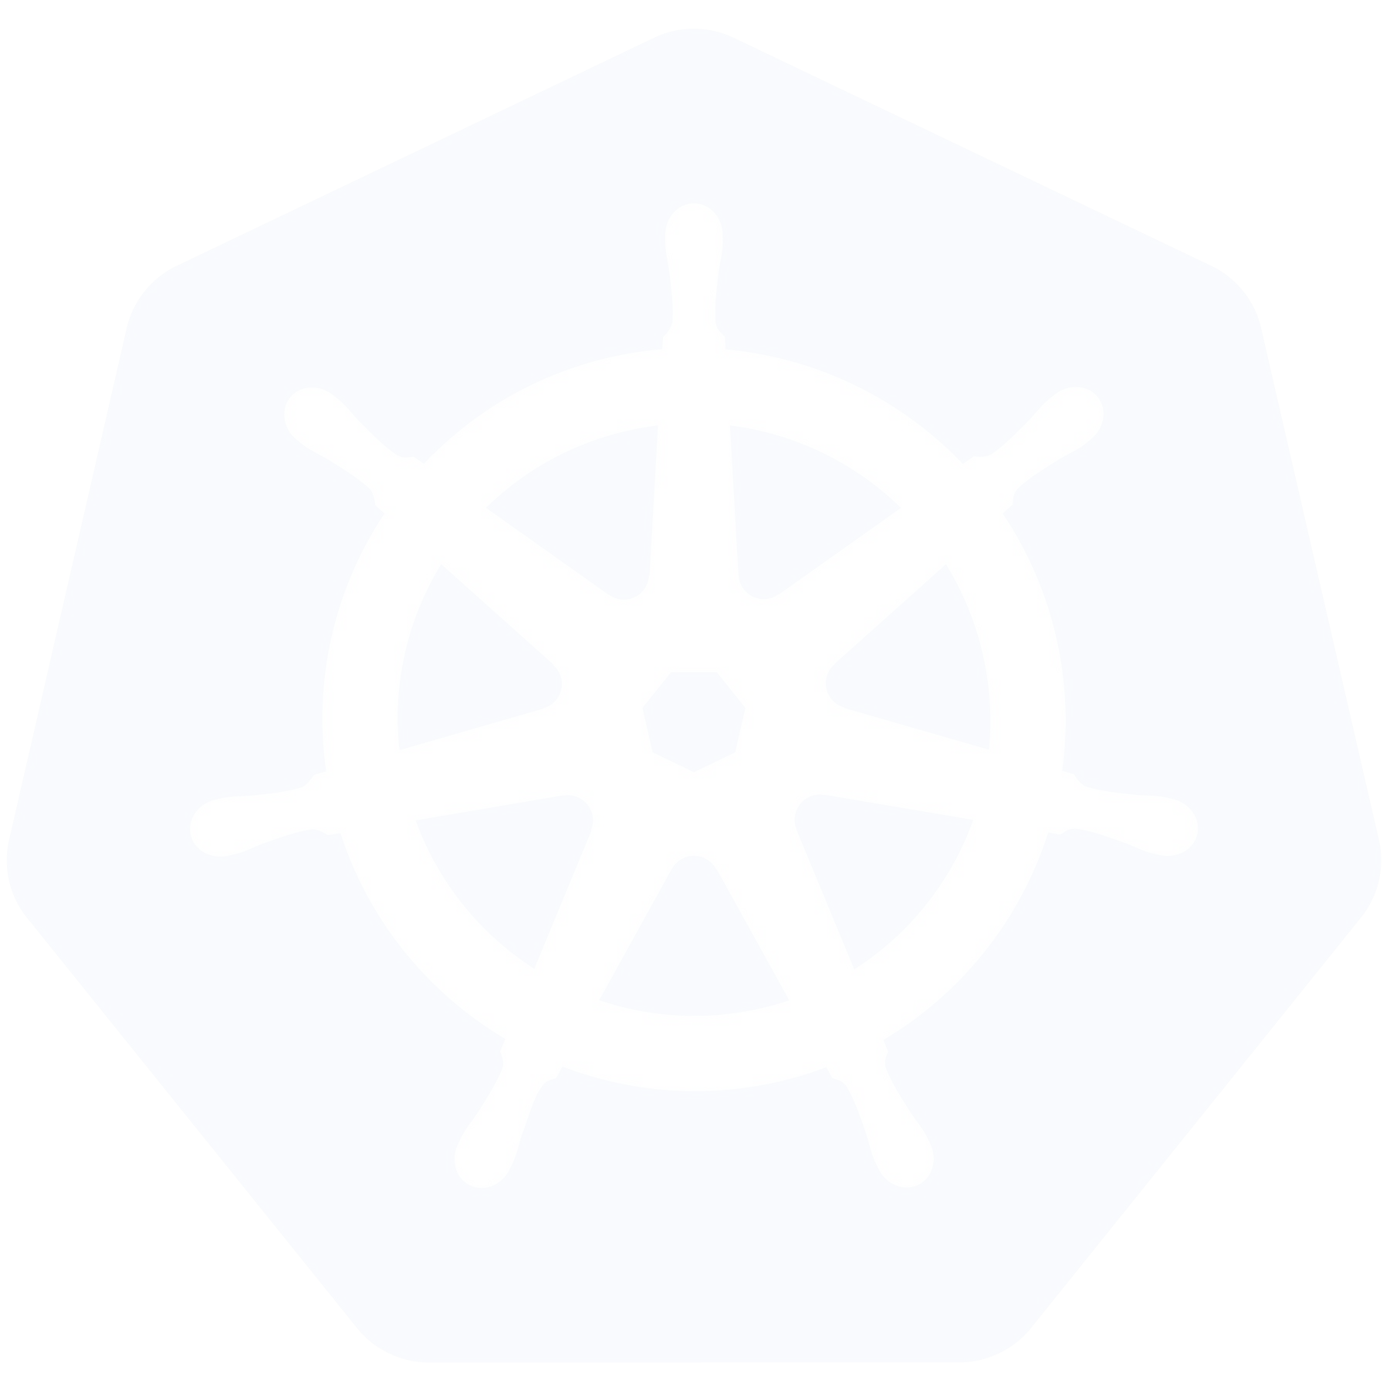
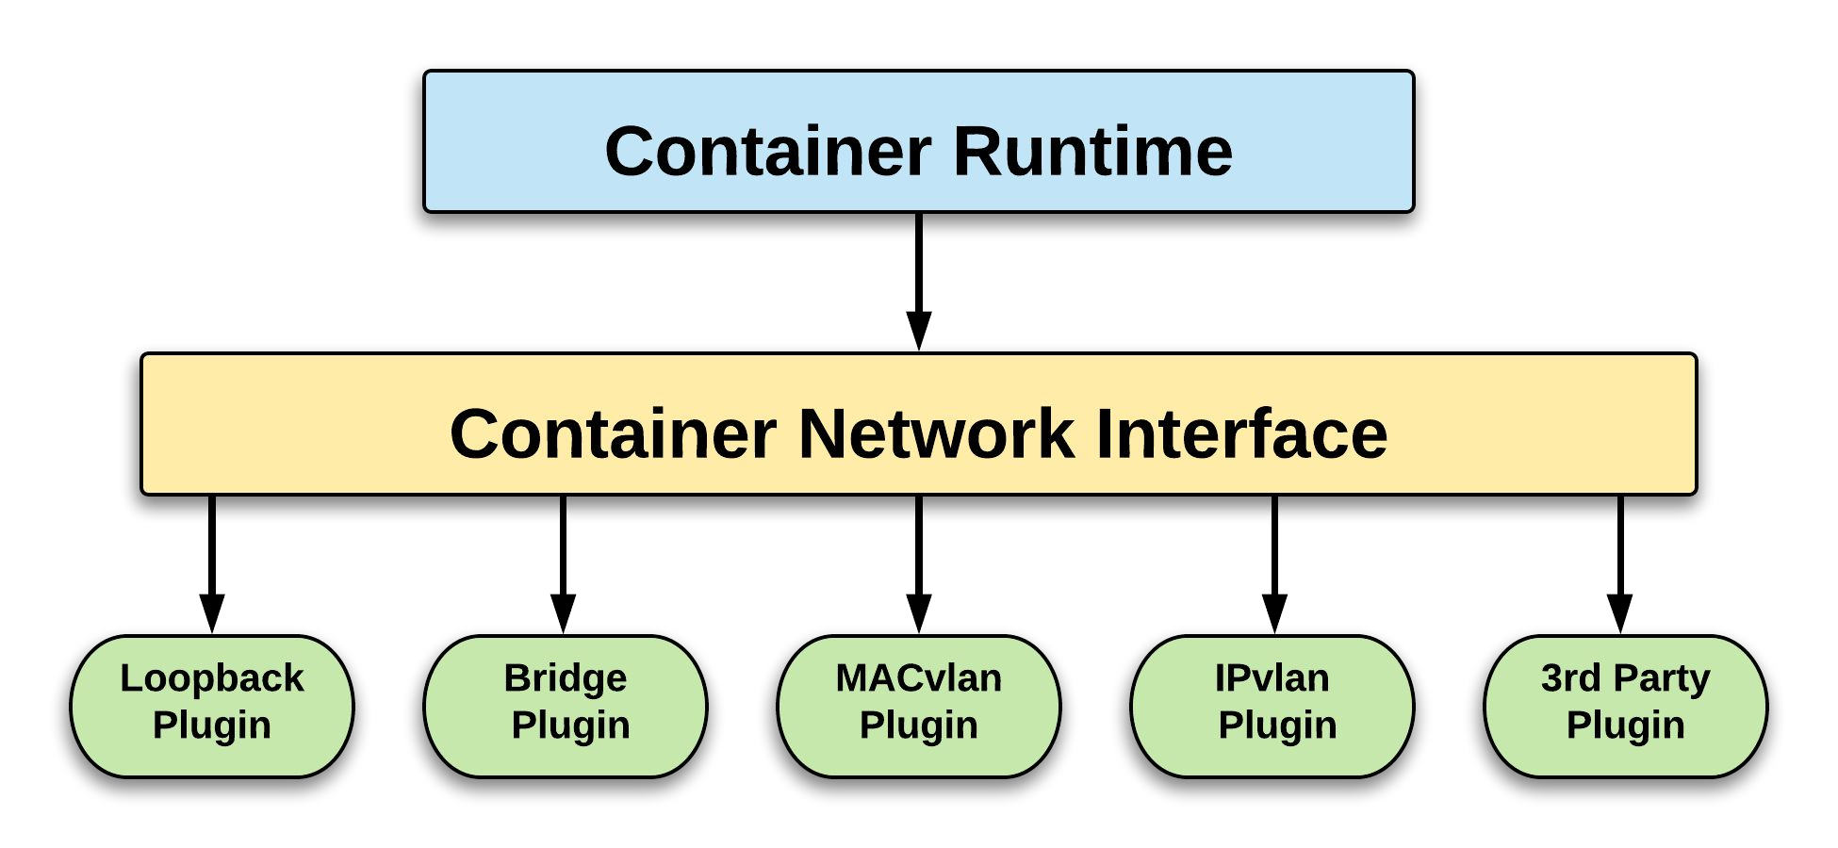
interface between the container runtime and a network implementation plugin

Slide 447

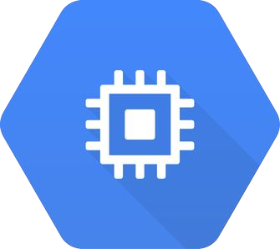









CNI 3rd Party Plugins
Flannel
Calico
Weave
Contiv
Cillium
AWS ECS
GCE
kube-router
Multus
OpenVSwitch
Romana

Slide 448
Why CNI for K8s? Basic Network Requirements
IPAM (IP address management) and lifecycle management of pods
Connectivity in the pod network
Reachability or routing usually run as daemonset
decouple network details from users or developers

Slide 449
So what does the CNI actually do
When creating a pod, the CNI will do 3 things:
create a pod network namespace and its interface eth0
Allocate an IP to the pod interface from the podCIDR defined in the plugin.
Make the Pod reachable by the whole cluster and potentially to the rest of the world.

Slide 450

K8s Runtime
"create a Pod on node X"
(API-SERVER)-------->(KUBELET)
CNI

Slide 451
Runtime
(KUBELET)
Pod netns
lo0
network config and env vars
enp8s0
network

Slide 452
Runtime
(KUBELET)
Pod netns
Create netns
eth0
Allocate IP
Define routes
eth0
CNI command
ADD)
enp8s0
network

Slide 453
Creating your own K8s CNI plugin

Slide 454
CNI is a simple interface based on environment variables and JSON
https://github.com/containernetworking/cni

Slide 455
CNI CONFIG
/etc/cni/net.d
RUNTIME
K8s
(kubelet)
CNI
/opt/cni/bin
enp0s8
network
CNI ENV VARS
CNI COMMANDS

Slide 456
CNI CONFIG
/etc/cni/net.d
RUNTIME
K8s
(kubelet)
CNI
/opt/cni/bin
enp0s8
network
CNI ENV VARS
CNI COMMANDS

Slide 457
CNI CONFIG
/etc/cni/net.d
POD/netns
eth0
bridge
RUNTIME
K8s
(kubelet)
veth0
CNI
/opt/cni/bin
output
eth0
network
CNI ENV VARS
CNI COMMANDS

Slide 458
Connectivity
create netns for Pod
create veth device pair
create bridge
add one end to netns and other end to bridge
add ip addressing for Pod and bridge interface
adding pod default gateway

Slide 459
CNI plugins composed of the 2 files for connectivity:
Network configuration file
JSON document located at /etc/cni/net.d
kubelet scans and parses this dir every 5 sec and pick the lowest ordered filename.
CNI Binary
located at /opt/cni/bin

Slide 460
CNI Environment Variables
CNI_COMMAND – This defines the operation, which can either be “ADD” or “DEL”.
CNI_CONTAINERID – This is a unique ID. If the request is associated with launching a rkt container, this is the container ID.
CNI_NETNS – Network namespace in which the network interface resides
CNI_IFNAME – The name of the network interface.
CNI_ARGS – This contains additional arguments, if any, specified by user.
1

Slide 461
CNI env vars
CNI_COMMAND=ADD \ CNI_CONTAINERID=$id \ CNI_NETNS=/proc/$pid/ns/net \ CNI_PATH=/opt/cni/bin \ CNI_IFNAME=eth0 \
...
CNI config json file
{
"cni-version": "0.4.0",
"name": "stratusnet",
"type": "stratus",
"podcidr": "10.244.1.0/24",
"bridge": "stratus0"
}

Slide 462
config=`cat /dev/stdin`
case $CNI_COMMAND in
ADD)
#network configuration of pods using output
template
;;
DEL)
removing network configuration
;;
GET)
runtime to query status of an interface
;;
VERSION)
CNI version
;;
esac
CNI BINARY

Slide 463
{
"cniVersion": "0.4.0",
"interfaces": [
{
"name": "%s",
"mac": "%s",
"sandbox": "%s"
} ],
"ips": [
{
"version": "%s",
"address": "%s",
"gateway": "%s",
"interface": 0
} ] }
Output Template in CNI Binary

Slide 464
output network config for Pod
{
"cniVersion": "0.4.0",
"interfaces": [
{
"name": "eth0",
"mac": "76:d4:e0:72:32:bc",
"sandbox": "/proc/6867/ns/net"
} ],
"ips": [
{
"version": "4",
"address": "10.244.3.45",
"gateway": "10.244.3.1",
"interface": 0 }
]
}

Slide 465
Reachability
1- Allow inter Pod communication within same node with iptables filter table FORWARD chain for pod cidr as src and dst.
2- inter Pod communication between nodes:
static route on each node in the cluster
3- pod communication to internet:
use NAT by masquerading the pod traffic with iptables nat table for pod cidr

Slide 466

IT's
DEMO TIME

Slide 467
Creating your own K8s CNI plugin Demo Lab

Slide 468
CNI CONFIG
RUNTIME
K8s
(kubelet)
CNI
enp0s8
network
CNI ENV VARS
CNI COMMANDS

Slide 469
CNI CONFIG
RUNTIME
K8s
(kubelet)
CNI
enp0s8
network
CNI ENV VARS
CNI COMMANDS

Slide 470
CNI CONFIG
POD/netns
eth0
bridge
RUNTIME
K8s
(kubelet)
veth0
CNI
output
eth0
network
CNI ENV VARS
CNI COMMANDS

Slide 471
The Weave net CNI

Slide 472
The Kubernetes Ingress

Slide 473
in·gress
/ˈinˌɡres/
noun
the action or fact of going in or entering and in our case ingress of external traffic in a Kubernetes cluster

Slide 474
So Why Ingress??
Why Ingress??

Slide 475
So Why Ingress??
Pod..
atomic resource that host a singular app...does not care about how traffic gets routed to it

Slide 476
So Why Ingress??
Services.
representation of a singular app
Does not care about routing.
adds one IP to a set of endpoint using labels..

Slide 477
Secret
SERVICES..
allows external traffic to applications using Load Balancer or NodePort Service
round robin L4 LB..managed by controller manager and exposes a singular application.
Need a LB or nodePort service for each application which can be $$$$ ..

Slide 478
So Why Ingress??
Kubernetes Ingress...
one VIP and domain name
maps external traffic to a set of services.. uses routing to map external traffic to a particular service exposing one application..we are talking about L7 ...
ingress--->service----> pod

Slide 479
So Why Ingress??
INGRESS == L7 LB
VIP , Domain name
TLS termination
virtual host
host based path routing
custom rules

Slide 480
TLS Offloading..terminate TLS encryption at Ingress
Virtual Host based routing. You can configure rules for your listener that forward requests based on the host field in the HTTP header. This enables you to route requests to multiple services using a single load balancer.
Path based routing. You can configure rules for your listener that forward requests based on the URL in the request. This enables you route requests to the correct service based on the content of the URL.

Slide 481
So Why Ingress??
How??

Slide 482
kubernetes ingress
Ingress resource
Ingress controller
Ingress proxy

Slide 483
control plane
Data plane
Ingress
controller
Ingress proxy
routes
Ingress
object
(resource)
Pod

Slide 484
Secret
Ingress object or resource
The Kubernetes declarative configuration for the ingress routing
Ingress controller -- BYOC bring your own controller
3rd party controller running separately from master. Control loop that read the ingress object config via the K8s API and programs the http routing in the ALB and the routes in the ingress proxy.
Ingress Proxy - routes the external HTTP traffic to services and their endpoints.

Slide 485
Path based
routing
(backend)
nodePort
Service
outside
world
Pod
Pod
cluster
target.lab.com/shop
INGRESS
controller
(L7 LB)
(backend)
nodePort
Service
Pod
K8s API
(backend)
clusterIP
Service
target.lab.com/help
Pod
Pod
Ingress Resource:
routing rules

Slide 486
Simple fanout...path based routing
apiVersion: extensions/v1beta1
kind: Ingress
metadata:
name: ingress-resource
annotations:
kubernetes.io/ingress.class: nginx
nginx.ingress.kubernetes.io/ssl-redirect: "false"
spec:
rules:
- host: target.lab.com
http:
paths:
- path: /hello
backend:
serviceName: hello-app
servicePort: 8080
- path: /shop
backend:
serviceName: cp-svc
servicePort: 8000

Slide 487
Virtual Host
nodePort
Service
outside
world
Pod
Pod
target.lab.com
cluster
INGRESS
controller (L7 LB)
nodePort
Service
Pod
www.shop.net
K8s API
clusterIP
Service
Pod
Pod
Ingress Resource:
routing rules

Slide 488
apiVersion: extensions/v1beta1
kind: Ingress
metadata:
name: ingress-resource
annotations:
kubernetes.io/ingress.class: nginx
nginx.ingress.kubernetes.io/ssl-redirect: "false"
spec:
rules:
- host: target.lab.com
http:
paths:
- path: /
backend:
serviceName: target-app
servicePort: 8080
- host: www.shop.net
http:
paths:
- path: /
backend:
serviceName: shop-app
servicePort: 5876
Virtual Host name mapping

Slide 489
TLS offloading
nodePort
Service
TLS
encryption
Pod
Pod
INGRESS
controller (L7LB)
nodePort
Service
No encryption
Pod
K8s API
clusterIP
Service
Pod
Pod
Ingress Resource:
routing rules

Slide 490
SSL/TLS Offloading
apiVersion: extensions/v1beta1
kind: Ingress
metadata:
name: ingress-resource
annotations:
kubernetes.io/ingress.class: nginx
nginx.ingress.kubernetes.io/ssl-redirect: "false"
spec:
tls:
- hosts:
- target.lab.com
secretName: tls-secret
rules:
- host: target.lab.com
http:
paths:
- path: /hello
backend:
serviceName: hello-app
servicePort: 8080

Slide 491
TLS offloading
nodePort
Service
TLS
encryption
Pod
Pod
INGRESS
controller/ingress proxy
nodePort
Service
No encryption
Pod
K8s API
clusterIP
Service
Pod
Pod
Ingress Resource:
routing rules

Slide 492
SSL/TLS Offloading
apiVersion: extensions/v1beta1
kind: Ingress
metadata:
name: ingress-resource
annotations:
kubernetes.io/ingress.class: nginx
nginx.ingress.kubernetes.io/ssl-redirect: "false"
spec:
tls:
- hosts:
- target.lab.com
secretName: tls-secret
rules:
- host: target.lab.com
http:
paths:
- path: /hello
backend:
serviceName: hello-app
servicePort: 8080

Slide 493
NGINX Ingress Controller
• Deployed as a pod using a Kubernetes deployment and exposed with a load balancer service.
• Community driven codebase
https://github.com/nginxinc/kubernetes-ingress

Slide 494

IT's
DEMO TIME

Slide 495
The Kubernetes Ingress Demo Lab with GCE

Slide 496
Note:
There are two Ingress classes available for GKE Ingress.
The gce class deploys an external load balancer and the gce-internal class deploys an internal load balancer.
Ingress resources without a class specified default to gce

Slide 497
In the demo lab, we will configure the ingress resource:
Path based routing aka simple fanout
Virtual Host mapping
TLS offloading
.

Slide 498
Path based
routing
(backend)
nodePort
Service
outside
world
Pod
Pod
cluster
target.lab.com/shop
INGRESS
controller
(L7 LB)
(backend)
nodePort
Service
Pod
K8s API
(backend)
clusterIP
Service
target.lab.com/help
Pod
Pod
Ingress Resource:
routing rules

Slide 499
Virtual Host mapping
nodePort
Service
outside
world
Pod
Pod
target.lab.com
cluster
INGRESS
controller (L7 LB)
nodePort
Service
Pod
shop.net
K8s API
clusterIP
Service
Pod
Pod
Ingress Resource:
routing rules

Slide 500
TLS offloading
nodePort
Service
TLS
encryption
Pod
Pod
INGRESS
controller/ingress proxy
nodePort
Service
No encryption
Pod
K8s API
clusterIP
Service
Pod
Pod
Ingress Resource:
routing rules

Slide 501
SSL/TLS Offloading
apiVersion: extensions/v1beta1
kind: Ingress
metadata:
name: ingress-resource
annotations:
kubernetes.io/ingress.class: nginx
nginx.ingress.kubernetes.io/ssl-redirect: "false"
spec:
tls:
- hosts:
- target.lab.com
secretName: tls-secret
rules:
- host: target.lab.com
http:
paths:
- path: /hello
backend:
serviceName: hello-app
servicePort: 8080

Slide 502

The flannel CNI

Slide 503
Flannel is one of the oldest CNI to provide network services for a Kubernetes cluster as a network addon. It is part of CoreOS technologies which distributes and maintains it.
https://github.com/flannel-io/flannel
Easy to install and use with the kube-flannel.yaml manifest
For Kubernetes v1.17+: $kubectl apply -f https://raw.githubusercontent.com/coreos/flannel/master/Documentation/kube-flannel.yml
This installs all the necessary kubernetes resources for flannel to operate

Slide 504
Flannel uses an overlay network with VXLAN as default encapsulation to allow. VXLAN uses ethernet for inter pod communication between nodes (wraps a Layer 2 packet in a UDP packet)
Flannel IPAM requires the use of the pod CIDR of 10.244.0.0/16 when initializing your kubeadm cluster with the command:
$kubeadm init --pod-network-cidr flag 10.244.0.0/16
Flannel will assign a unique subnet from the pod CIDR for each node.

Slide 505
CNI flannel Demo Lab

Slide 506

Installing the Weave CNI

Slide 507
https://www.weave.works/blog/weave-net-kubernetes-integration/
https://kubernetes.io/docs/setup/production-environment/tools/kubeadm/high-availability/
Only one command:
kubectl apply -f "https://cloud.weave.works/k8s/net?k8s-version=$(kubectl version | base64 | tr -d '\n')"

Slide 508

The Calico CNI

Slide 509
Project Calico, a Tigera open-source project that provides a layer 3 network implementation, aimed at scalable datacenter deployments.
https://docs.projectcalico.org/getting-started/kubernetes/

Slide 510
Calico has a highly scalable and distributed control plane
Layer 3 Internet scale architecture..associate virtual router with each node. Uses BGP and IP-in-IP encapsulation by default
no bridge. no overlay. Low overhead
Calico supports network policies.
IPAM dynamically allocates small blocks of IP addresses to nodes

Slide 511
Felix: Calico daemonset that is run as daemonset to program BGP tables and iptables. Writes to the etcd
BIRD: BGP client for pod connectivity that distributes BGP routing information.
Can use BGP route reflector for higher scale.

Slide 512

network namespace
10.1.0.1
network
namespace
10.1.0.2
eth0
eth0
ROOT
netns
cali1234@if4
cali0133@if3
BIRD
bgp
Felix
enp0s8

Slide 513
Installing the Calico CNI

Slide 515
Cluster Installation and Maintenance

Slide 516

What is Kubeadm?

Slide 517
Installing Kubernetes the "Hard Way" is a great learning experience but it is ..hard and time consuming.
Kubeadm was born from the cluster lifecycle SIG (special Interest Group) ..provides a simple way to automate the setup of a best practice, conformant cluster for each Kubernetes minor version.
Kubeadm also allows for the upgrade, downgrade and deletion of the cluster

Slide 518
The kubeadm initiates the installation with
with the following steps
$kubeadm init --pod-network-cidr <pod cidr> --apiserver-advertise-address <host IP address>
1- it creates all the TLS certificates to secure communication between the control plane components and the API server.
2- Then creates the client TLS certificates in Kubeconfig files

Slide 519
3- it creates all static pods for etcd and control plane components in the kube-system namespace.
4- waits for kubelet to run the static pods...kubelet runs a linux service and needs to be started and active.

Slide 520
Kubeadm does not setup the CNI and is agnostic to the administration of the kubelet.
Kubeadm uses a phased installation approach

Slide 521
Kubeadm cluster upgrade can be done with
$kubeadm upgrade plan
$kubeadm upgrade apply <k8s version>
Note: supported upgrades can be only one minor version at a time. this is shown with the kubeadm upgrade plan command

Slide 522
Release Versioning in Kubernetes

Slide 523
One critical task of a Kubernetes admin is make sure that his cluster(s) are up to date.
Cluster Upgrades are key to add more functionality, patch security vulnerabilities, bug fixes etc..

Slide 524
Kubernetes uses the semantics versioning
X.Y.Z
X: major version for API incompatible changes
Y: minor version to add new functionality
Z: patch version for critical bug fixes for the minor version and security vulnerability fixes.
Y and Z are backward compatible to the most 3 recent minor releases (1.19, 1.18, 1.17)

Slide 525
Kubernetes release cycle for a minor version broken down in 4 phases
feature
definition
feature
work
bug fixing
release GA

Slide 526
Kubernetes release lifecycle for a minor version
patch versions on weekly basis or up to a month
minor versions every 3 months
minor versions supported for about 9 months
The Kubernetes project will support only up to 3 minor versions at one time (1.19,1.18,1.17)
https://github.com/kubernetes/sig-release/blob/master/releases/patch-releases.md

Slide 527
1.18
1.20
1.18.z
1.17.z
1.19.z
1.17
1.19

Slide 528
1.18
1.20
1.18.z
1.17.z
1.19.z
1.20.z
1.17
1.19

Slide 529
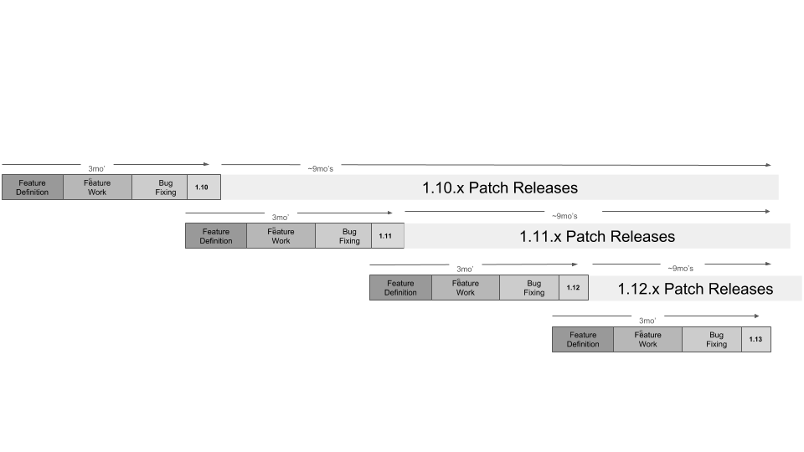
source: https://github.com/kubernetes/community/blob/master/contributors/devel/sig-release/release-lifecycle.png

Slide 530
All Kubernetes releases can be listed with:
curl -s
https://packages.cloud.google.com/apt/dists/kubernetes-xenial/main/binary-amd64/Packages | grep Version | awk '{print $2}'
$apt-cache madison kubeadm command.

Slide 531
Draining your Nodes

Slide 532
When managing a Kubernetes cluster, it is important how to handle disruptions to your applications or your pods.
Kubernetes classify these as 2 types of disruption:
involuntary disruption
voluntary disruption
https://kubernetes.io/docs/concepts/workloads/pods/disruptions/#voluntary-and-involuntary-disruptions

Slide 533
Involuntary disruptions that will cause a pod to be terminated or evicted from a node refers to some unavoidable software, hardware or user error
ie..node crashing, node OS crashing or cloud VM stopped for cost reasons or node running out of CPU/memory resources.

Slide 534
Voluntary disruptions where a pod was deleted by a user or the node which was hosting the pod was stopped or deleted by a user.
Kubernetes allows the cluster to gracefully accommodate these disruptions by draining the nodes with the $kubectl drain command

Slide 535

The kubectl drain command allow safely evict pods with the following steps:
cordon the node by making the node unschedulable ( taints the node)
Safely evicts and deletes pods while respecting the pod disruption budgets or PDBs.

Slide 536
when a pod is not part of a replicated application, the system will request to use the --force flag as the pod will be terminated and not recreated.
Otherwise the pod is deleted and recreated on another node.
Pod Disruption Budgets or PDBs are a kubernetes resource. They limits the number of pods of a replicated application that are down simultaneously from voluntary disruptions
This pdb requires at least two replicas to be available at any point in time:
$kubectl create poddisruptionbudget my-pdb --selector=app=web --min-available=2

Slide 537
Note that there are pods that cannot be deleted by the drain command:
daemonsets..need to use the --ignore-daemonset flag to override
If a pod is using EmptyDir{} as a storage volume..need to use the --delete-local-data flag to override.
Static Pods..as they are managed by Kubelet

Slide 538
Installing Kubeadm Clusters

Slide 539
where available kubernetes <version> is:
$curl -s https://packages.cloud.google.com/apt/dists/kubernetes-xenial/main/binary-amd64/Packages | grep Version | awk '{print $2}'
$apt-cache madison kubeadm
apt-cache's madison command attempts to mimic the output format and a subset of the functionality of the Debian archive management tool, madison. It displays available versions of a package in a tabular format

Slide 540
To install a specific version of kubeadm :
apt-get install -y kubeadm=<version>
However kubectl and kubelet packages are installed by dependencies when we install kubeadm so all three packages should be installed with a specific version:
sudo apt-get install -y kubelet=<version> kubectl=<version> kubeadm=<version>
Install the container runtime of your choice
Then just do init and join the worker nodes

Slide 541
Installing a Highly Available Kubeadm Cluster

Slide 542
Upgrading your Kubeadm clusters

Slide 543
Kubernetes "The Hard Way"

Slide 544
ETCD Backup and Restore Operations.

Slide 545
Installing Vagrant and VBox

Slide 546
Vagrant is a tool to build and manage VMs from HashiCorp
https://www.vagrantup.com/

Slide 547
VBox or VirtualBox is an open source hypervisor from Oracle
https://www.virtualbox.org/wiki/Downloads

Slide 548
Github repo for vagrant files
https://github.com/chkp-dhouari/Mastering-Kubernetes

Slide 549
Understanding Resource Limits and Requests

Slide 550
Kubernetes allows the orchestration of containerized applications in pods hosted in nodes.
By default, there is NO LIMIT on how much resource a pod and its container(s) can consume
A lack of resource can impact your apps as it can prevent scheduling, cause eviction of a pod and performance degradation.

Slide 551
Requests and Limits are the mechanism used by Kubernetes to control CPU and Memory consumed by container(s) in pod.
They are set on a per container basis.
Requests: Amount of CPU/Memory that a pod or container is guaranteed to receive
Limits: Ensure that a pod or container does not consume CPU/Mem above the set threshold

Slide 552

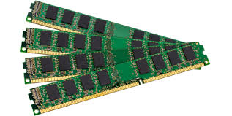
Resource Types

Slide 553
CPU:
Defined in millicores. One VM core equals to 1000m cores. ½ VM core equals 500m cores and so one.
if you request more than what is available on a node, the pod will not be scheduled until the scheduler finds a suitable node
If a limit is reached, CPU is throttled back by Kubernetes

Slide 554
MEMORY:
Defined in Kilobytes or Kibibytes and so on. If a limit threshold is reached, the pod and its container are terminated
Note that 1024 = 1Ki but 1000 = 1KB
1024K=1Gi but 1000K=1GB

Slide 555
apiVersion: v1
kind: Pod
metadata:
name: myapp
spec:
containers:
- name: test
image: nginx
resources:
requests:
memory: 50Mi
cpu: 200m
limits:
memory: 100Mi
cpu: 500m

Slide 556
Administrators can set limits on namespaces. Useful to control resource usage by teams that are running multiple projects on the cluster.
apiVersion: v1
kind: ResourceQuota
metadata:
name: appquota
spec:
hard:
requests.cpu: 600m
requests.memory: 60Mi
limits.cpu: 700m
limits.memory: 100Mi
pods: 2
count/deployments.apps: 3
Requests and limits are for all cpu and memory requests and limits within a namespace
quota can be set for objects with count/resource.group and
storage requested as well

Slide 557
Understanding Resource Limits and Requests Demo Lab

Slide 558
Dockerfile Entrypoint & CMD

Slide 559
Multi-Container Pods

Slide 560
Pods or applications should have only one main application container.
There are cases where there is a need of more than container within a pod
Additional containers in the same pod can provide helper processes to the main application container or add more functionality without having to refactor the main application code.

Slide 561
Placing these containers in the same Pod has advantages:
managed as one unit under a logical host being the pod.
freely communicate and exchange data within the same pod as they can share the same network namespace and storage.

Slide 562
Shared network namespace: no need of routing or bridging. All containers cannot connect via localhost
pod network namespace
con2
con1
con3
localhost

Slide 563
Shared Storage: containers can exchange data with volumes.
pod
con2
con1
volume
emptyDir{}
localhost
external storage
con3

Slide 564
Multi-container Design Patterns

Slide 565

Sidecar pattern
Like a bike sidecar.. tightly coupled with the main bike to provide additional seating or storage
For containers, sidecar containers are used to provide logging, monitoring or offload other tasks to assist the main application container

Slide 566

Ambassador pattern:
Like an ambassador represent a country and negotiating on the behalf of his/her government
For containers, ambassador containers are typically used as a proxy to send or receive network or API requests

Slide 567
apiVersion: v1
kind: Pod
metadata:
name: test5
spec:
containers:
- name: test
image: httpd
volumeMounts:
- name: vol1
mountPath: /var/www/html
- name: init
image: busybox
command: ["/bin/sh"]
args: ["-c","echo '<html><h1>Welcome to Kubernetes</html>' >> /var/cka/index.html"]
volumeMounts:
- name: vol1
mountPath: /var/cka
volumes:
- name: vol1
emptyDir: {}

Slide 568
Multi-container Pods Demo Lab

Slide 569
TLS Certificates Explained

Slide 570

Securing access to your clusters is critical. It would be like securing access to your home or your most prized possessions.
Breaches, ransomware, DDoS attacks are every day news and cost business millions and more

Slide 571
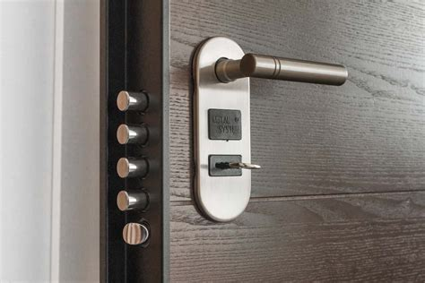
Need to implement the most secure security system to your cluster just as you would setup the most secure lock to the door of your home

Slide 572
TLS or Transport layer Security and its predecessor SSL are the most widely used security protocol on the internet..
TLS provides the following element:
authentication and verification
encryption of data

Slide 573

Authentication and verification:
Provide a user with credentials and certifying those credentials with a trusted 3rd party source like a passport certified by some government authority

Slide 574
How does it work?
TLS is composed of a public key and a private key.
The public key is like the lock on a door. It is visible and accessible to all but only one key can unlock it..the private key that you do not share with anyone.

Slide 575

However you need to ensure that the public key is not fake just to get a copy of your private key.
That' s where the certificate authority or CA comes in to certify that the public key used in the genuine public key

Slide 576


Certificate Authority
Certificate Signing Request
Public Key of John Doe signed by John's private key
Name: John_Doe
Org: Admin
Address: beverly Hills
Country: USA
Public Key of John Doe
Name: John_Doe
Org: Admin
Address: beverly Hills
Country: USA
The Certificate Authority
validates the public Key of Joe and signs it with its key
Signing the CSR proves ownership of the private key corresponding to the public key in the CSR

Slide 577
Anatomy of a cybersecurity attack on Kubernetes by exploiting code vulnerabilities

Slide 578
There are many CVEs that are affecting container images used by containerized applications deployed in a Kubernetes cluster.
These CVEs are generally not patched and can be used to hijack credentials to gain root or privileged access to a Kubernetes cluster

Slide 579


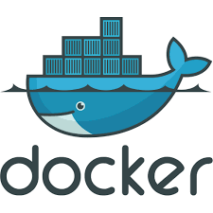
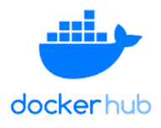

CICD Pipeline

Slide 580

CVEs or Common Vulnerabilities and Exposures are cybersecurity flaws.
They tracked by a CVE ID and published by security advisories by the MITRE ATT&CK framework

Slide 581
The goal is to obtain user or service account credentials that can be authenticated with the cluster and with root or privileged permissions to do some damage..
in this lab I will demonstrate how to do that with CVE-2014-6271

Slide 582

Shellshock aka {bashdoor} is a vulnerability impacting web servers like apache allowing an attacker to cause vulnerable versions of Bash to execute arbitrary commands.
This can allow an attacker to gain unauthorized access to a computer system.

Slide 583
The Kubernetes Monitoring Architecture

Slide 584
Monitoring the actual resource usage of your apps is critical to getting the maximum performance out of your cluster while ensuring the reliability and stability of your cluster
This can also allow to set proper resources requests and limits under various actual cluster loads and be used for the Pod Autoscaler

Slide 585

So..How this does actually work??

Slide 586
Metrics is data as a numeric measurement at a fixed point of time of a system resources like CPU load
Monitoring is the collecting, the storage and reporting of the aggregated metrics data at a fixed point of time or over a certain period of time.

Slide 587
Per Google, the 4 golden signals are the most critical elements to monitor a distributed system like Kubernetes:
https://sre.google/sre-book/monitoring-distributed-systems/
Latency : The time it takes to service a request;
Traffic : A measure of how much demand is being placed on the system;
Errors : The rate of requests that fails;
Saturation : How “full” our service is, basically how close we are to exhausting system resources

Slide 588



There are many monitoring solutions for Kubernetes to determine application resource usage and overall cluster performance….
KUBERNETES METRICS-
SERVER

Slide 589
Regardless of the tool that you chose to use, there are 2 types of metrics pipeline to monitor your cluster:
Resource metrics pipeline
metrics-server : CPU and Memory for the node and containers.
Full metric pipeline
prometheus etc.. for more
type of metrics (node, API server, etcd)

Slide 590
Metrics Server collects resource metrics from Kubelets and exposes them in Kubernetes apiserver through the Metrics API
The Metrics Server only provide actual resources usage and not historical
for use by Horizontal Pod Autoscaler and Vertical Pod Autoscaler.
The Metrics API can be accessed by
$ kubectl top command
https://github.com/kubernetes-sigs/metrics-server

Slide 591

cAdvisor is embedded into the kubelet and collects container metrics known as “core” metrics for each pod in a node:
CPU Usage (user and system) and time throttled
Filesystem read/writes/limits
Memory usage and limits
Network transmit/receive/dropped
node
pod
kubelet

Slide 592
node
node
pod
pod
kubelet
kubelet

Slide 593
node
node
Heapster was the first resource metrics solution. It run as a pod that connects to all the CAdvisors and scrapes all the metrics. heapster is no longer used by Kubernetes.
pod
pod
Heapster
kubelet
kubelet

Slide 594
node
node
Metrics Server runs as a deployment with one pod and expose by a service. It connects to all the CAdvisors on all the nodes and scrapes all the CPU and Memory metrics.
pod
pod
Metrics Server
kubelet
kubelet

Slide 595
node
node
$kubectl top command
/METRICS API
pod
Metrics Server
pod
kubelet
kubelet

Slide 596
The Kubernetes Metrics Server installation and Demo Lab

Slide 597
Managing Applications Logs

Slide 598
When running applications and containerized applications in particular, logging is one of the most critical thing to have and master.
Logs will help the cluster admin and devops teams to debug and troubleshoot applications quickly by identifying errors patterns and bugs.

Slide 599
With containerized applications in a Kubernetes cluster, logs are generated by the containers.
With Docker containers, logs are generated by Docker engine and stored in the host in a log file.

Slide 600
Applications write their logs to a log file using standard I/O streams.
APPLICATION
LOG file at
/var/log/containers

Slide 601
What are standard I/O streams?
in Linux system, a stream is something that can transfer data. In the case of these streams, that data is text
I/O is input and output of data.
These standard streams are the communication channels between the application program and its environment with stdin, stdout and stderr.

Slide 602
Applications write their logs to a log file using standard I/O streams.
stdin -- text as input to app
stdout -- text as output from the app
stderr -- text as output of error messages
stdout
LOG file
/var/log/containers
APPLICATION
stderr
stdin

Slide 603
With Docker, logs are encapsulated in JSON-map
{"log":"2021-04-19 15:49:03.355667 I | etcdserver/api/etcdhttp: /health OK (status code 200)\n",
"stream":"stderr",
"time":"2021-04-19T15:49:03.355836772Z"}

Slide 604
How to collect logs in docker?
$docker logs <container name>
How to stream logs:
$docker logs -f <container name>

Slide 605
How to collect logs for a pod?
$kubectl logs <pod_name>
Multi-container pods:
$kubectl logs <pod_name> -c <container>
How to stream logs
$kubectl logs -f <pod> -c <container>

Slide 606
How to collect logs for systemd component like kubelet and docker?
$journalctl -u kubelet
$journalctl -u docker

Slide 607
Managing Applications Logs Demo Lab

Slide 608
The Elasticsearch Fluentd Kibana (EFK) Logging Stack for Kubernetes

Slide 609


The EFK stack is a suite of tools combining Elasticsearch, fluentd and Kibana also known as a logging pipeline.
This stack is a popular and powerful solution for log management and analysis in Kubernetes.
THE EFK LOGGING STACK

Slide 610
Fluentd
collect and aggregate all the logging data on each node and ships that to elasticseach
Elasticsearch
search engine using distributed data storage to index and store the logging data heap from each node.
Kibana
Provide a dashboard for Elasticsearch for visualization and analysis.

Slide 611
Each EFK tool is available for installation as binary or as a docker container images making it easy to deploy.
Fluentd is deployed as a daemonSet with a pod on each node.
Elasticsearch is deployed as statefulSet and Kibana as a deployment and fronted with a kubernetes service .

Slide 612
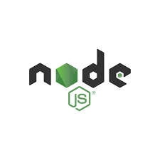
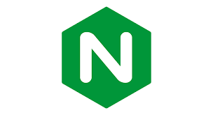
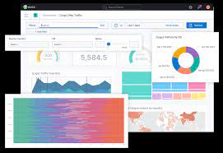
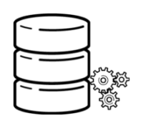
log aggregation
log indexing and storage
visualization & analysis
NODE 1
container logs, system logs, etc..

Slide 613
The Elasticsearch Fluentd Kibana (EFK) Logging Stack for Kubernetes Demo Lab.

Slide 614
Service for external access to UI
statefulSet
NODE 1
daemonset
container logs.
pv
deployment

Slide 615
Troubleshooting Cluster failures

Slide 616
To successfully troubleshoot cluster failures it is important to understand the cluster architecture. That is the role of each control plane component and how they interacts with each other.
ie kube-apiserver, controller manager, kubelet etc...

Slide 617
Since this is geared towards the CKA exam we will focus on kubeadm but this would apply to any type of K8s cluster.
With kubeadm, the only control plane component not running as a pod is the kubelet and it runs as a linux systemd service

Slide 618
Troubleshooting components running as pod would be the same as any other pods as follow:
$ kubectl describe pod -n kube-system
$ kubectl logs (-c container) pod_name -n kube-system
verify the logs under /var/log/containers
ensure that authentication and authorization is ok
review how the static pods are initialized

Slide 619
Kubelet is a critical control plane component as it is responsible for the node health and join for the cluster as well as the lifecycle of pods.
must master the troubleshooting of the kubelet.
kubelet service configuration
/var/lib/kubelet/admin.conf
logs:
$ journalctl -ru kubelet or -fu to stream logs

Slide 620
Troubleshooting Applications Failures

